Slide 2
Food packaging
Most cardboard boxes and other food packaging are made up using nets. Can you remember what a net is, think back to maths?
A design is then added onto the net and it is printed out and then assembled before the food is put inside and it is sent to the shops.
We are going to look at the nets that make up the food packaging in our homes and what information goes on them. Then next lesson we are going to design our own packaging on Purple Mash.

Slide 3
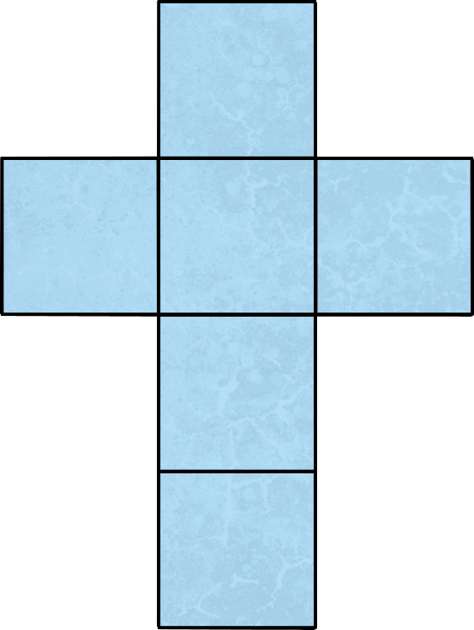
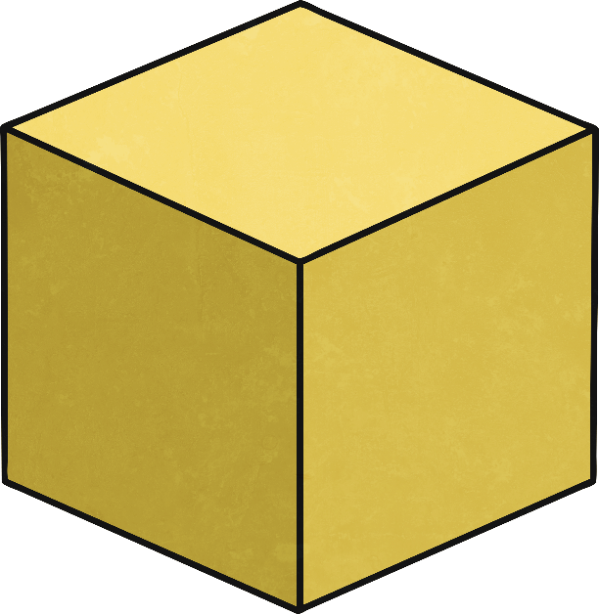
What shape does this net make?
Cube

Slide 4
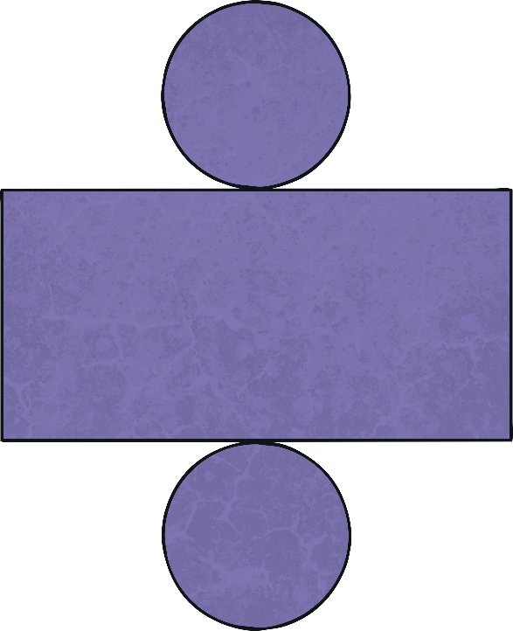
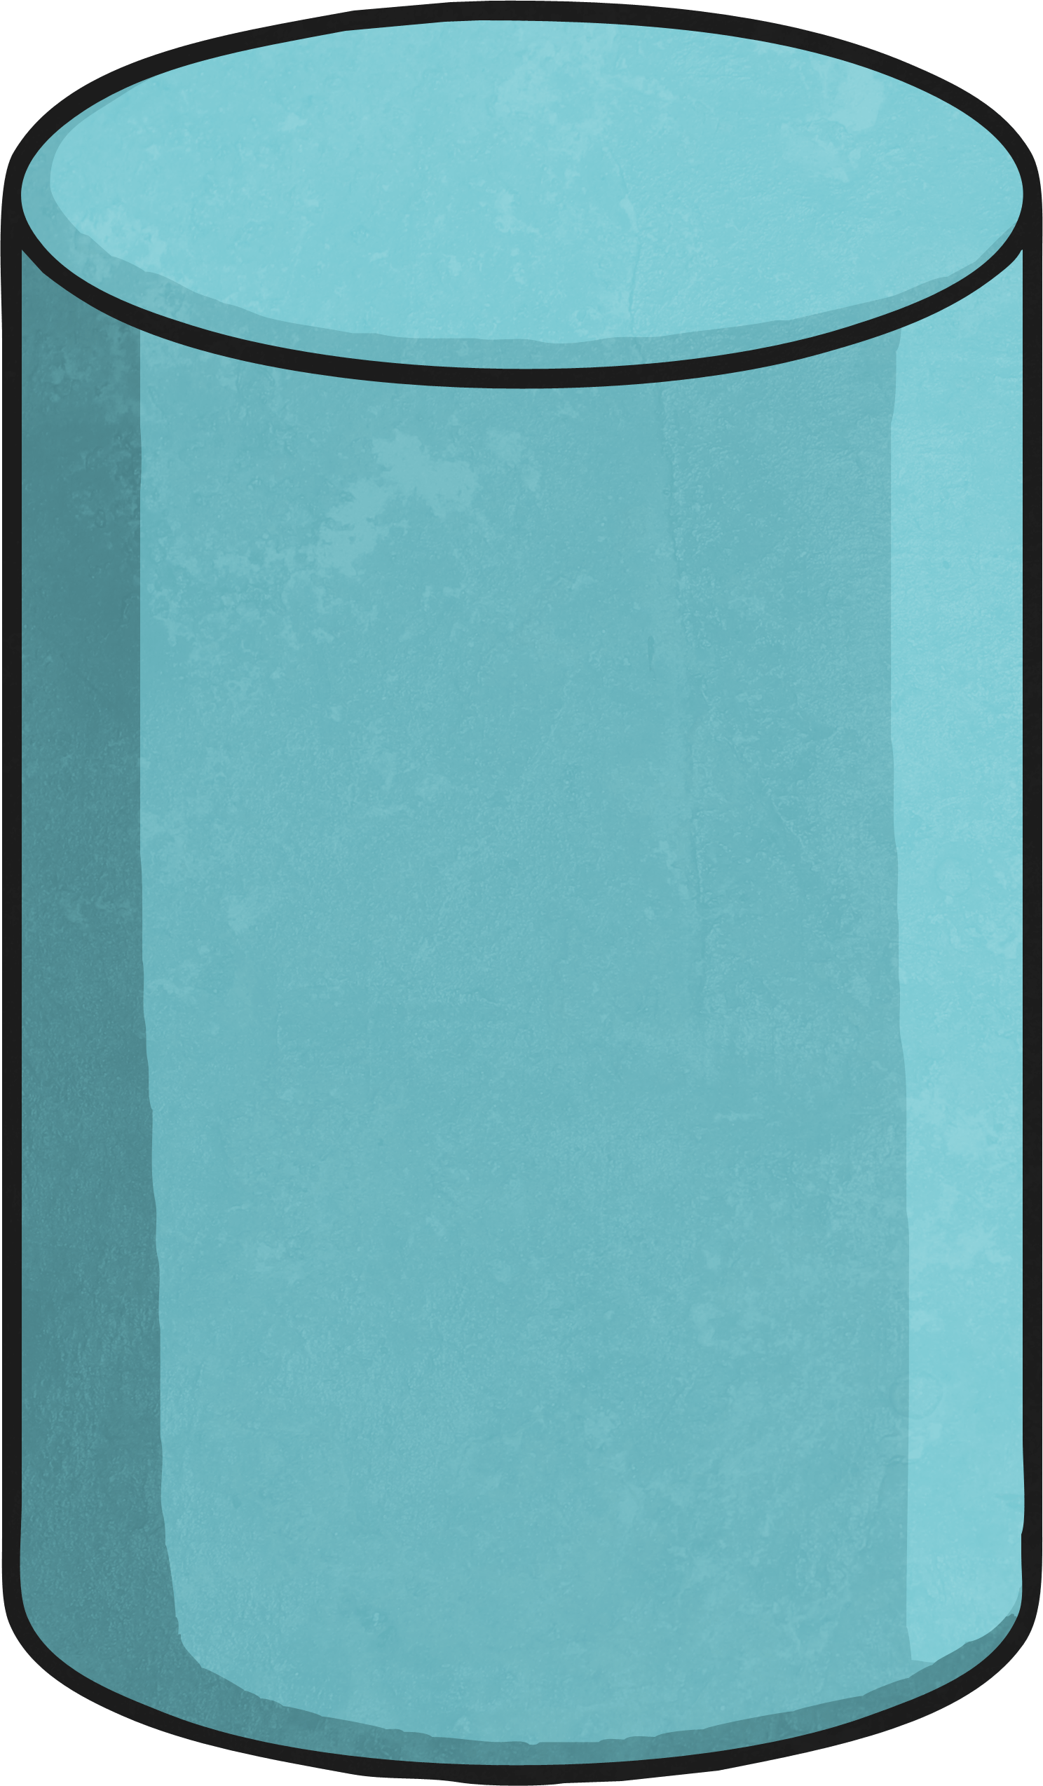
What shape does this net make?
Cylinder

Slide 5
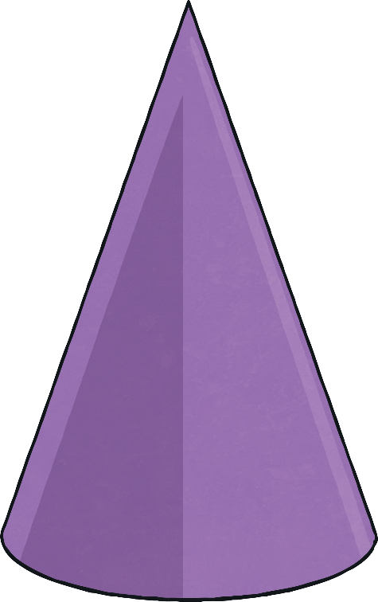
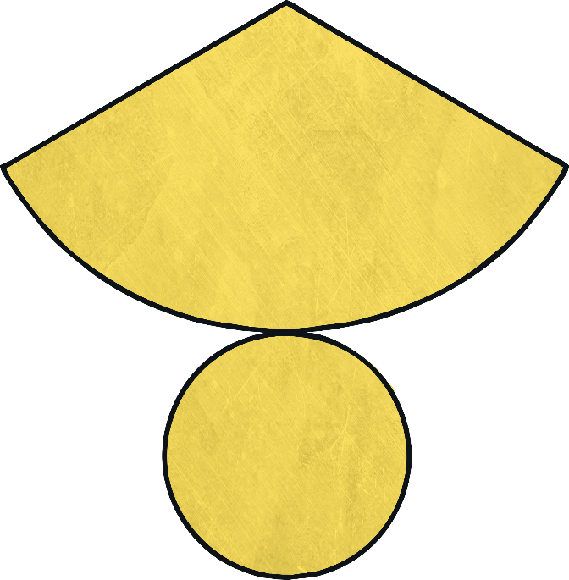
What shape does this net make?
Cone

Slide 6
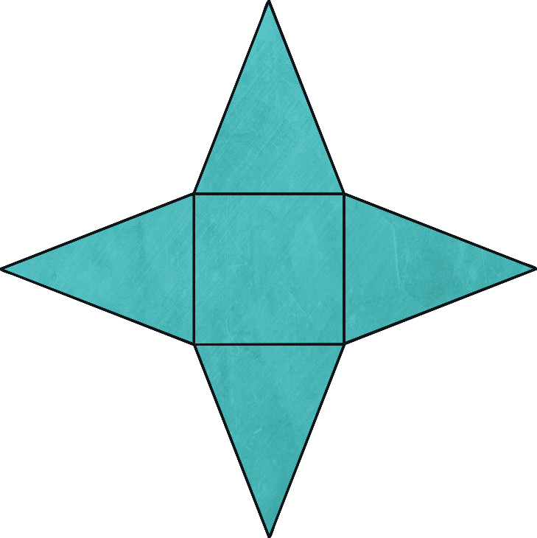
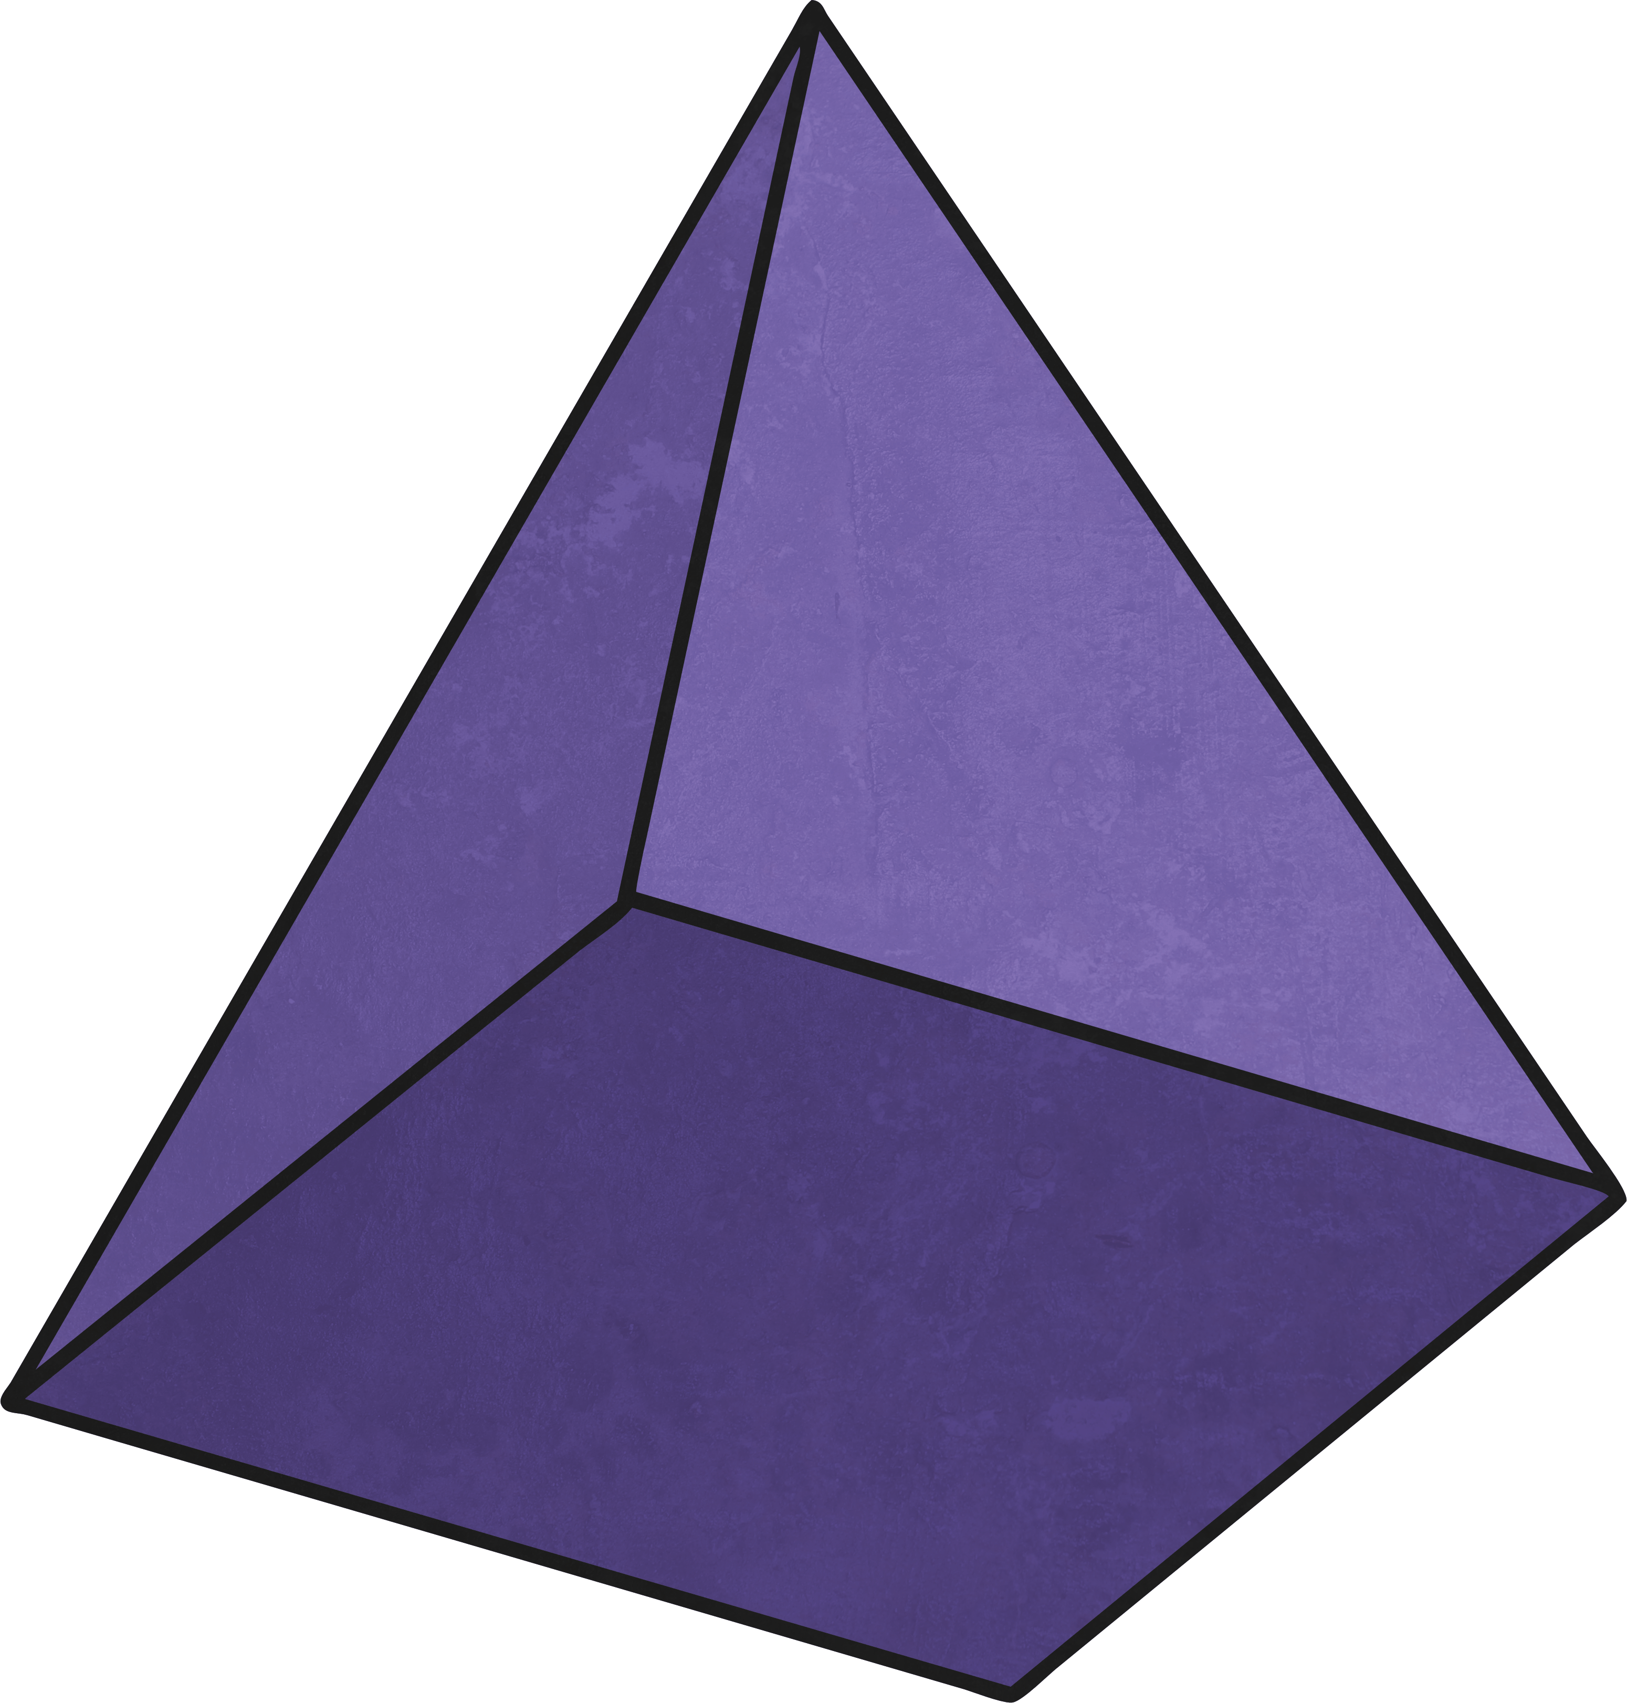
What shape does this net make?
Square-Based Pyramid

Slide 7
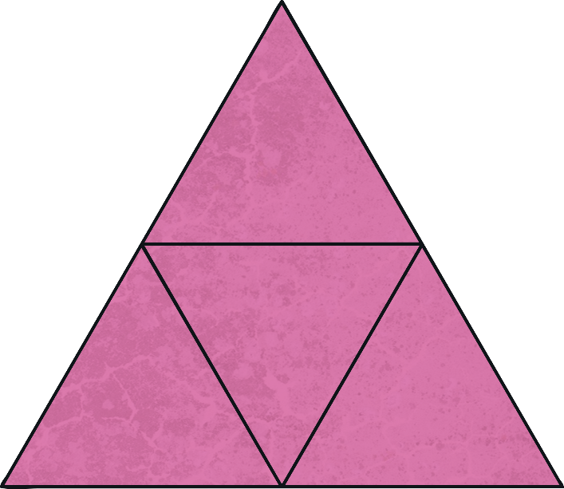
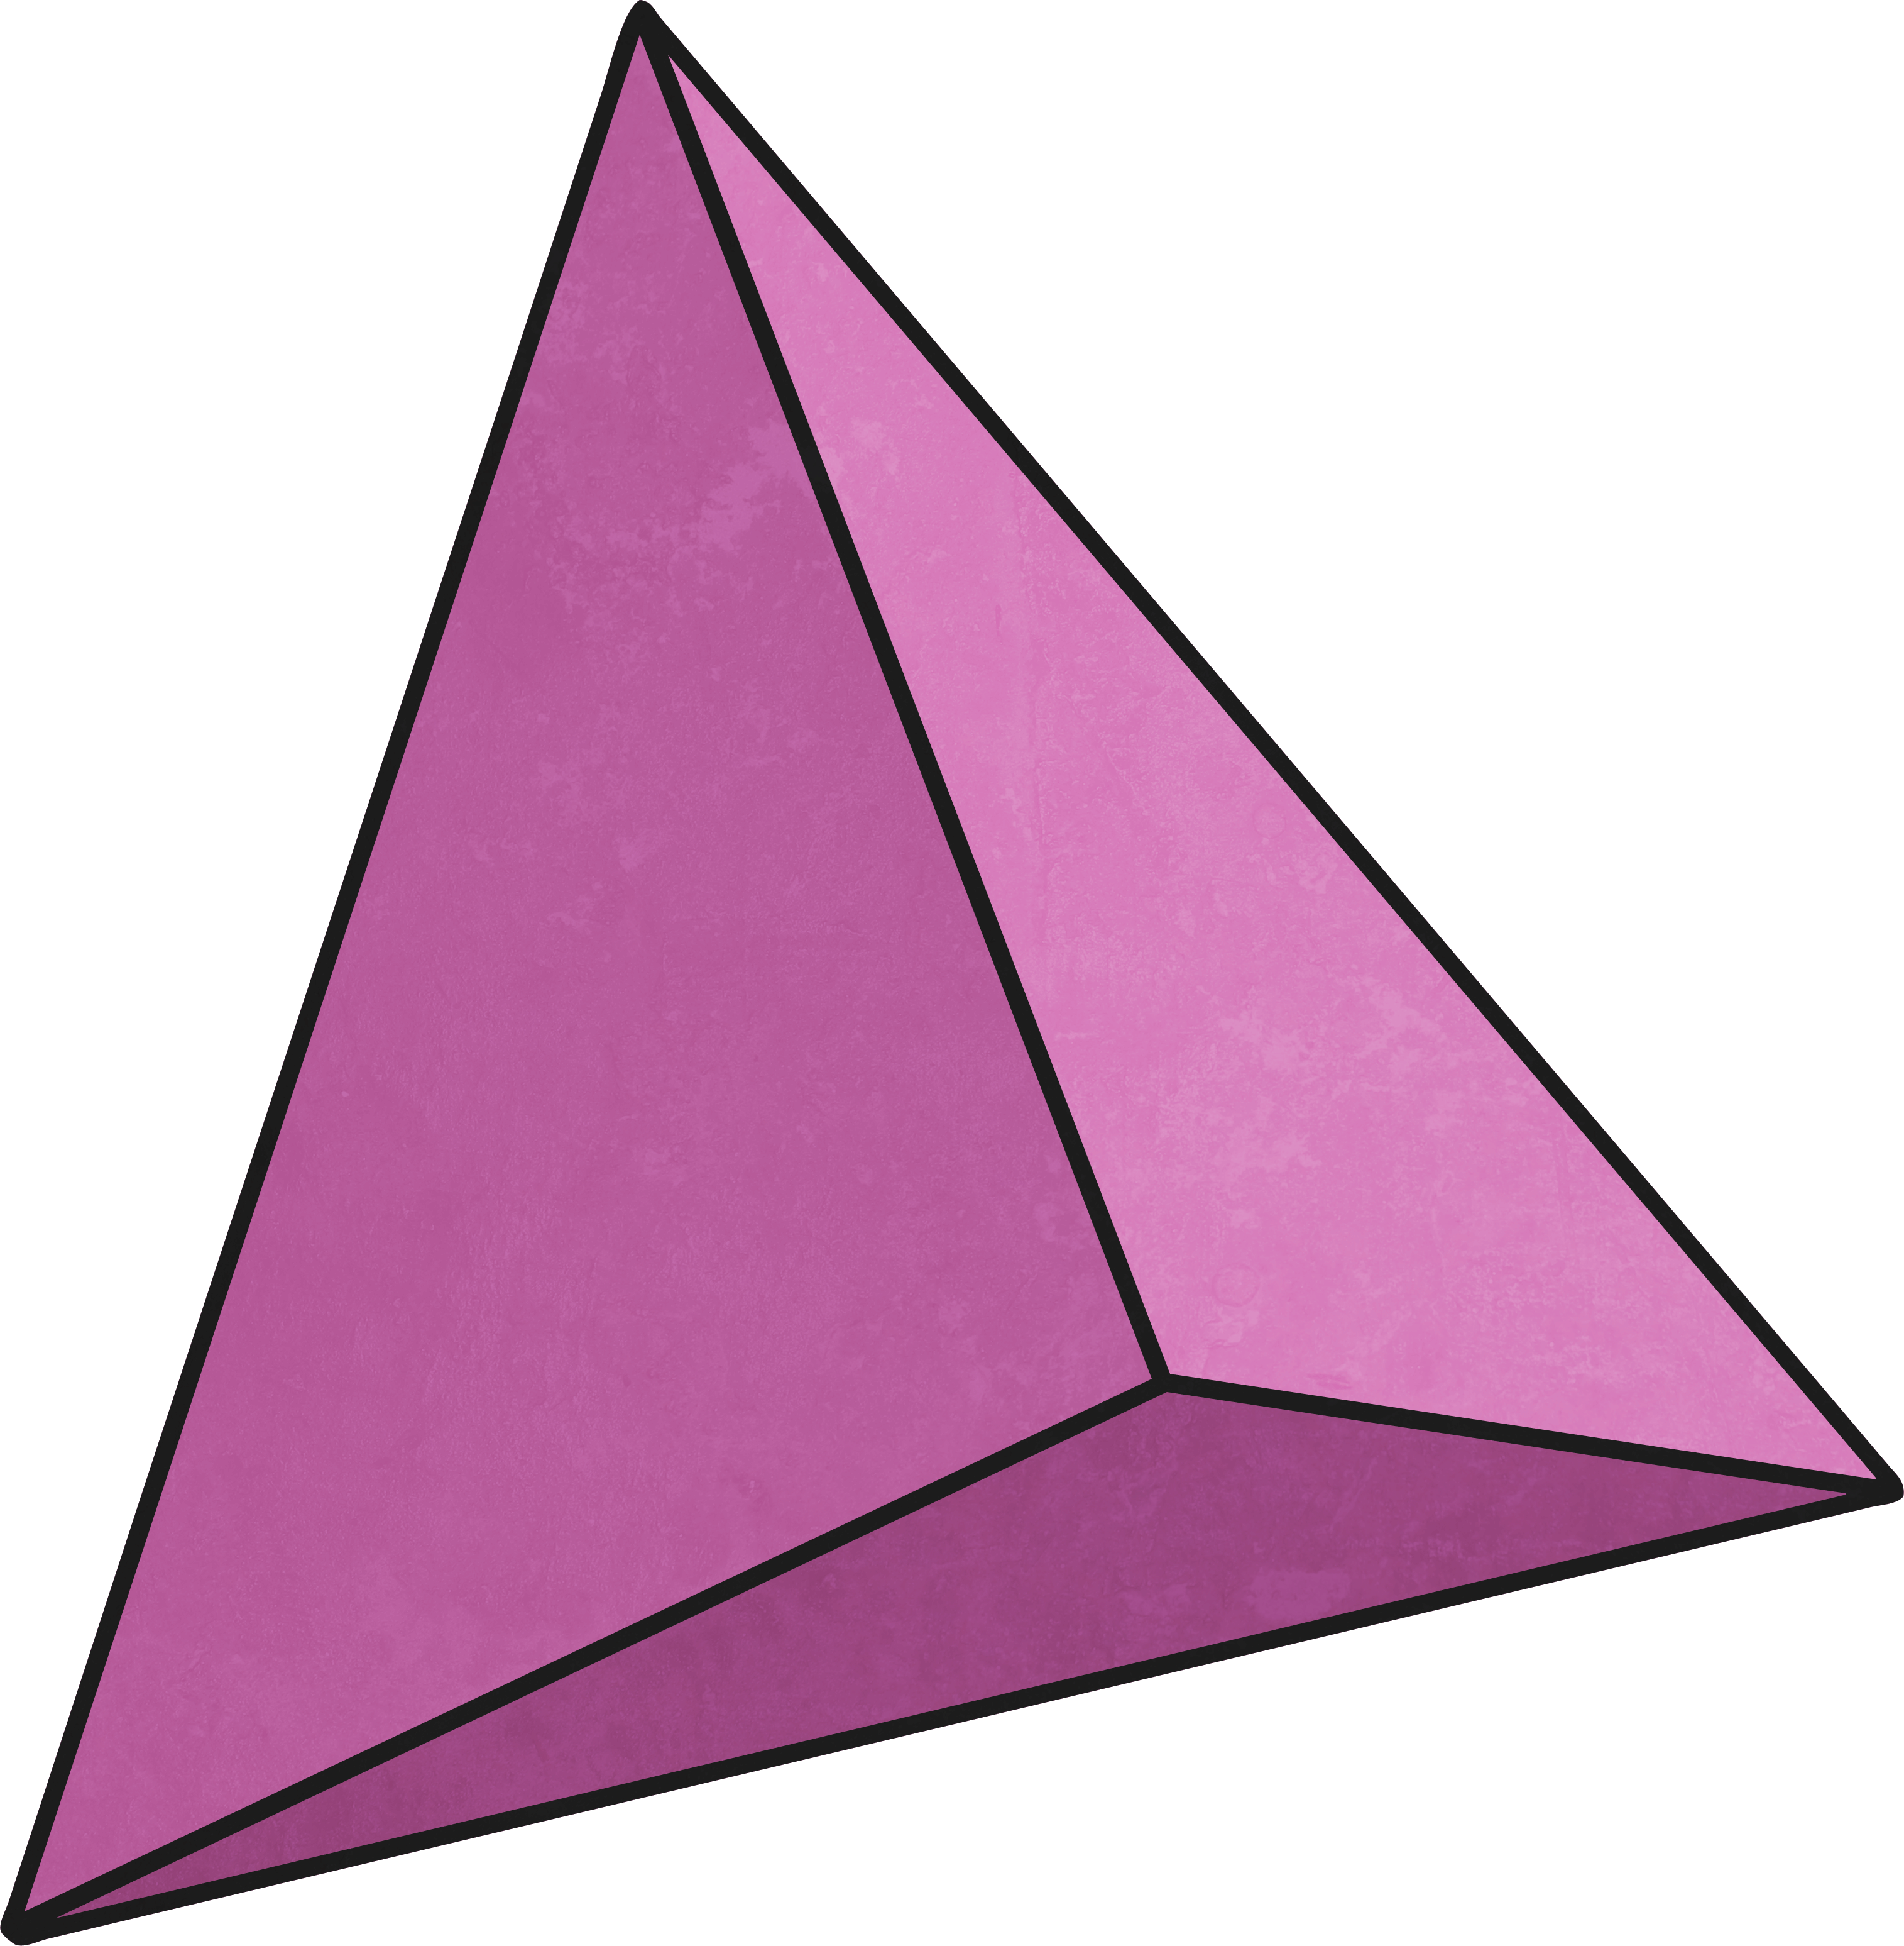
What shape does this net make?
Triangular Pyramid

Slide 8
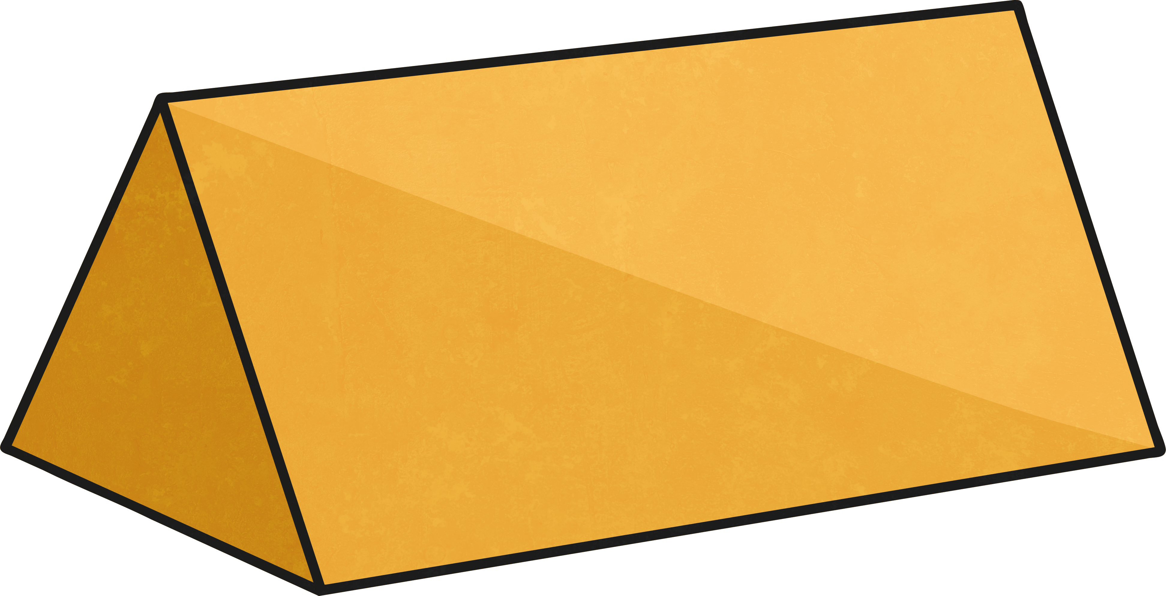
What shape does this net make?
Triangular Prism

Slide 9
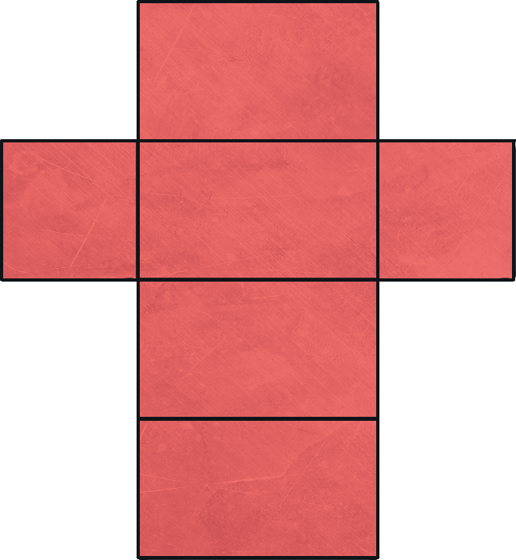
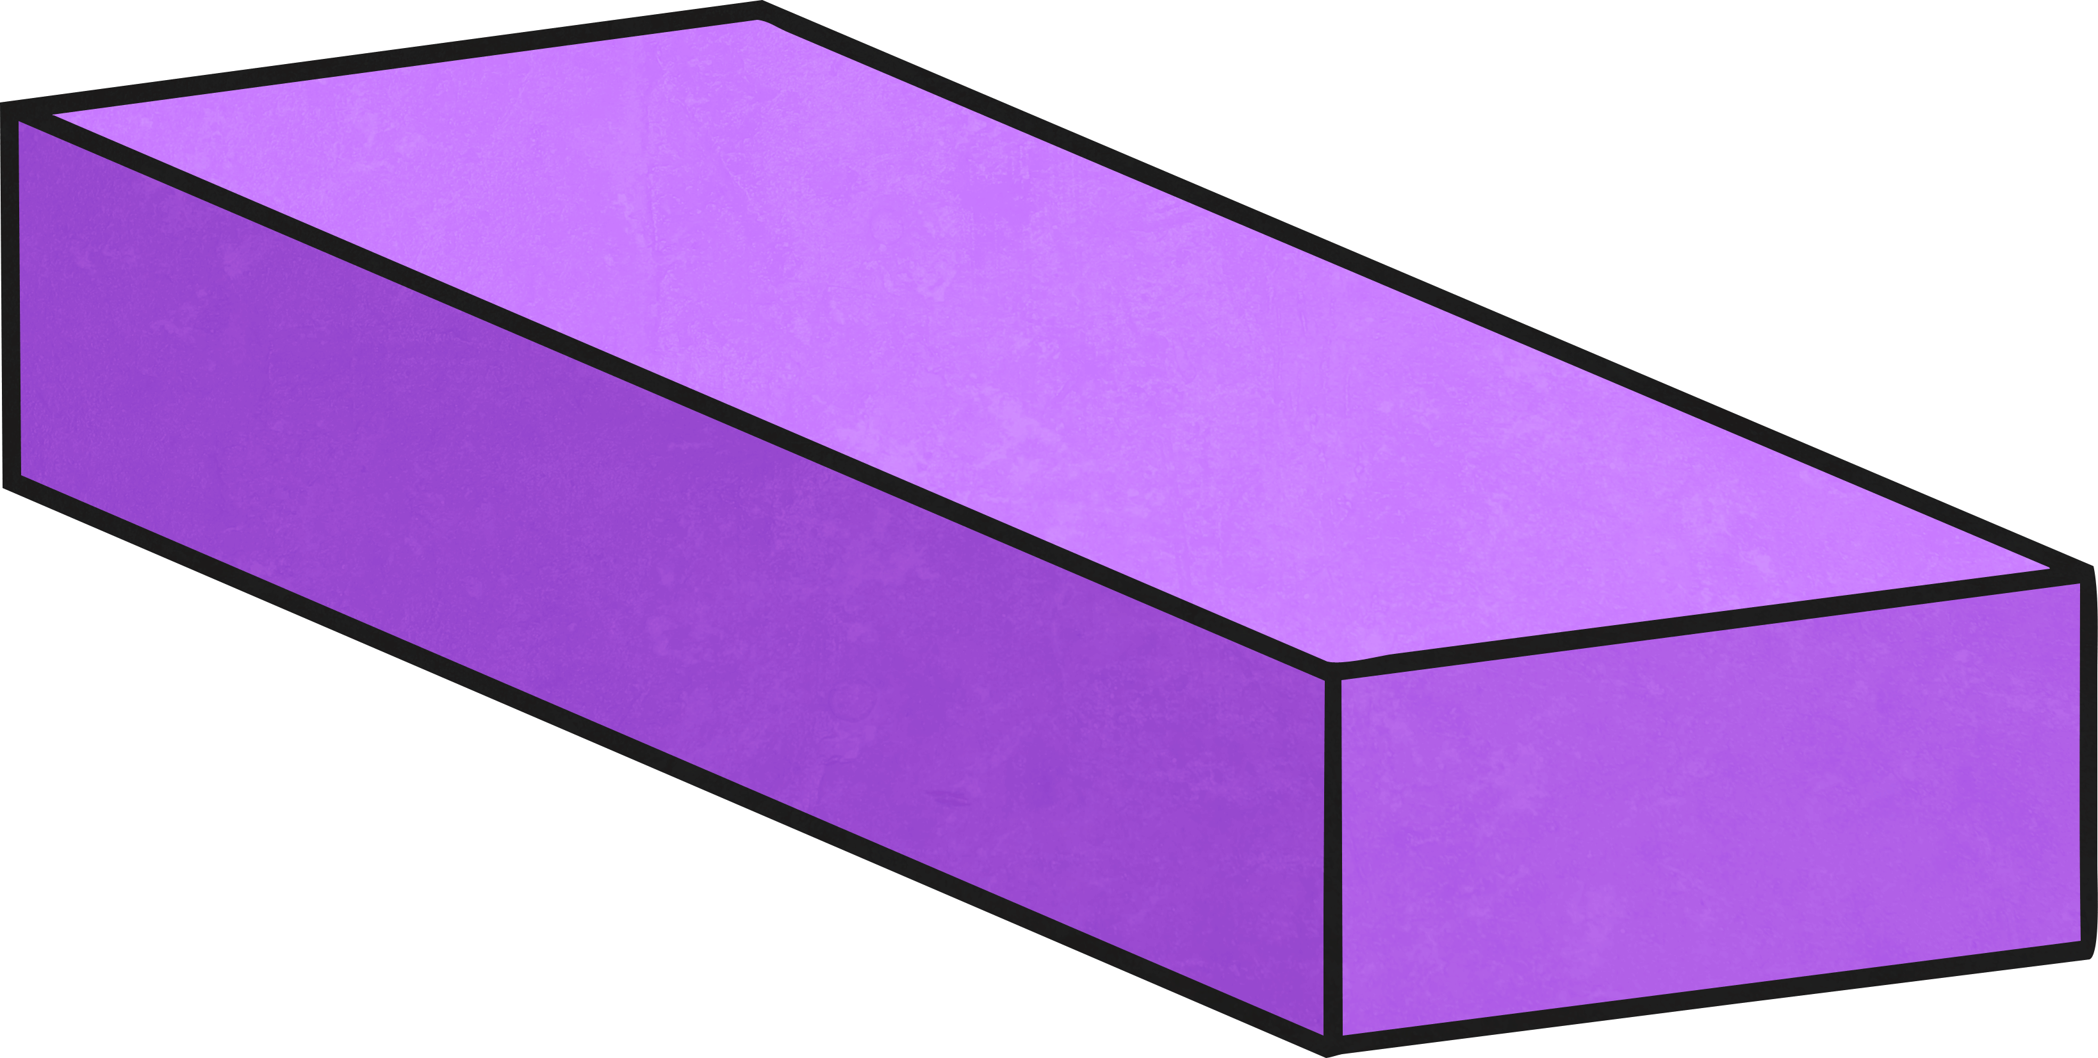
What shape does this net make?
Cuboid

Slide 10
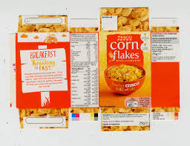
Food packaging
Which shape do you think is most commonly used in food packaging?
Have a look in your kitchen cupboards which shape can you see the most?
Look back at the net for that shape.

Slide 11
Food packaging
Check with your grown up and see if you can have 2 examples of food packaging for this activity.
Look at packaging made by food companies. What are they made out of? What information can be found on the packaging (weight, product description, ingredients, logo, picture, nutrition information...). Can you record your answers, maybe in a table?
3) Why was this material chosen?
4) If okay with your grown up carefully disassemble the packaging. How was it made? If the packaging is a box, what is the net like? Are there any other nets which will make the same box?
3) Discuss what happens to the materials once they have been used. Can they be recycled? Can they be used again? Can the packaging be made from any other materials?

Slide 12
Food packaging
Begin to think ahead for next lesson,
Which shape are you going to use for your food packaging?
What would you call your company/product?
What other information are you going to put on your packaging?
On the Class 3 webpage there is a link to different nets, you could have a go at printing them and then building the nets to make 3D shapes.

