Slide 1
Monday 11th January

Slide 2
Phonics - Phase 3
Can you remember the phonemes that we have learned?
See how quickly you can move through the slides saying each phoneme out loud.

Slide 3
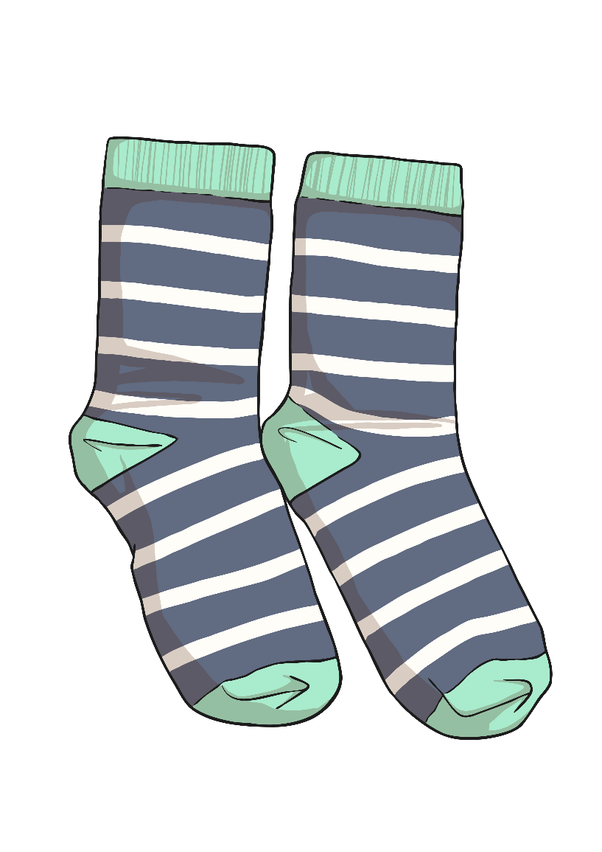
s

Slide 4
t

Slide 5
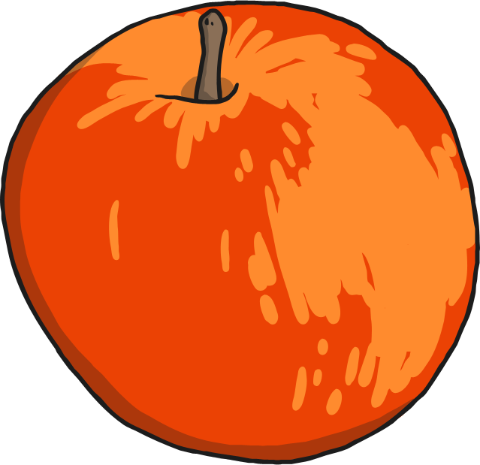
a

Slide 6
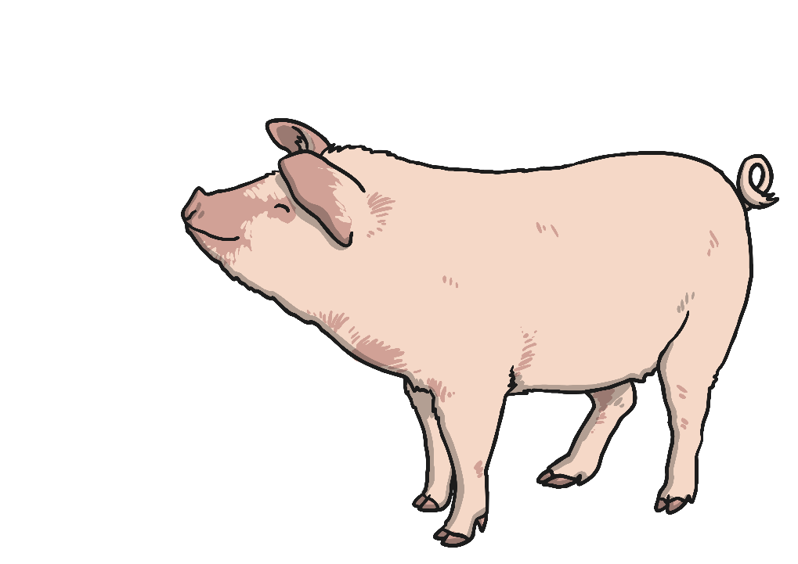
p

Slide 7
i

Slide 8
n

Slide 9
m

Slide 10
d

Slide 11
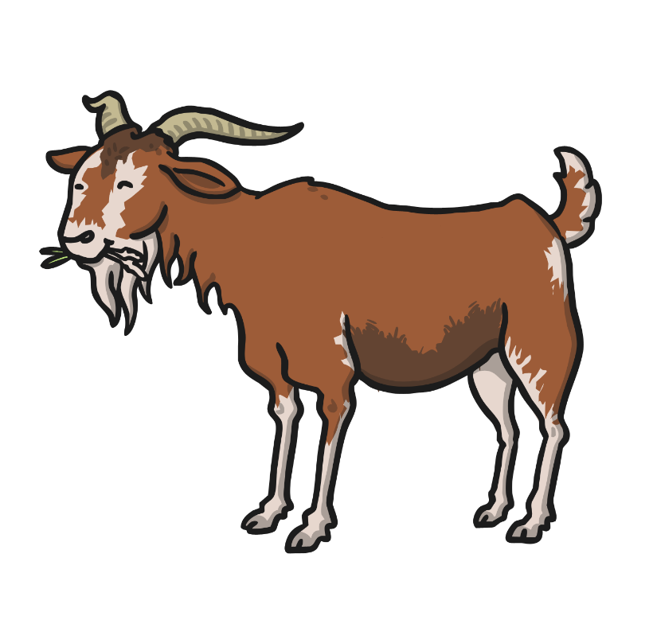
g

Slide 12
o

Slide 13
c

Slide 14
k

Slide 15
ck

Slide 16
e

Slide 17
u

Slide 18
r

Slide 19
h

Slide 20
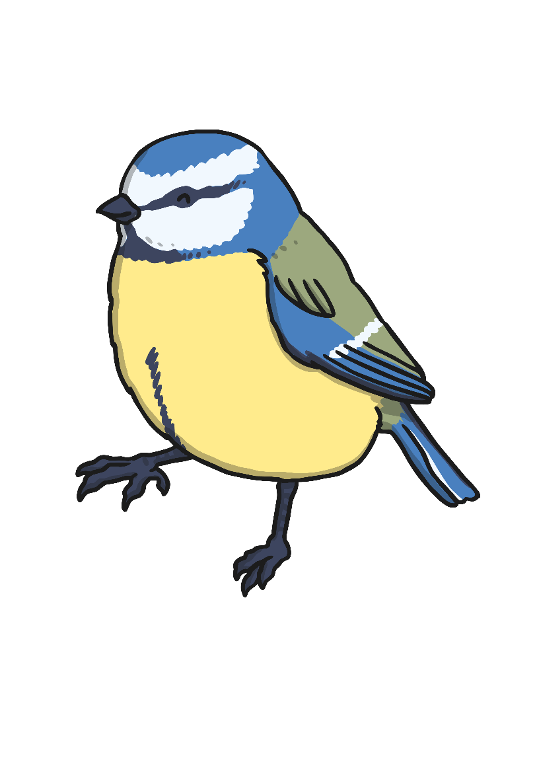
b

Slide 21
f

Slide 22
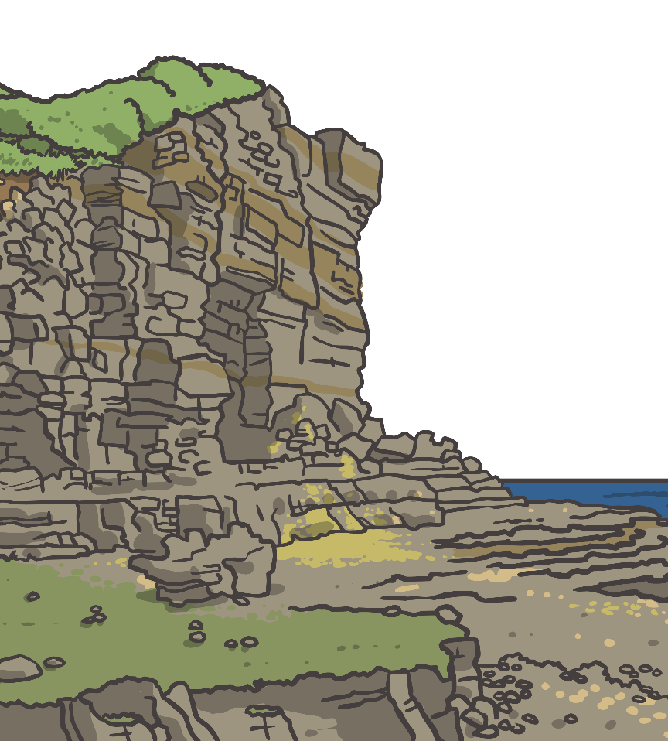
ff

Slide 23
l

Slide 24
ll

Slide 25
ss

Slide 26
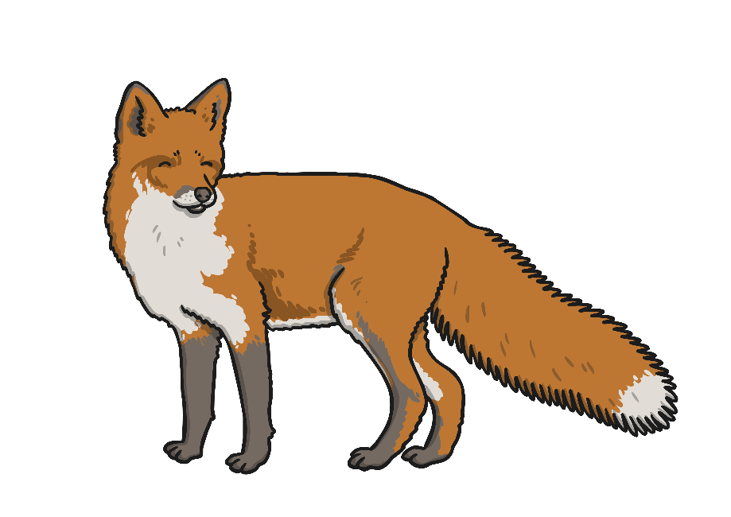
x

Slide 27
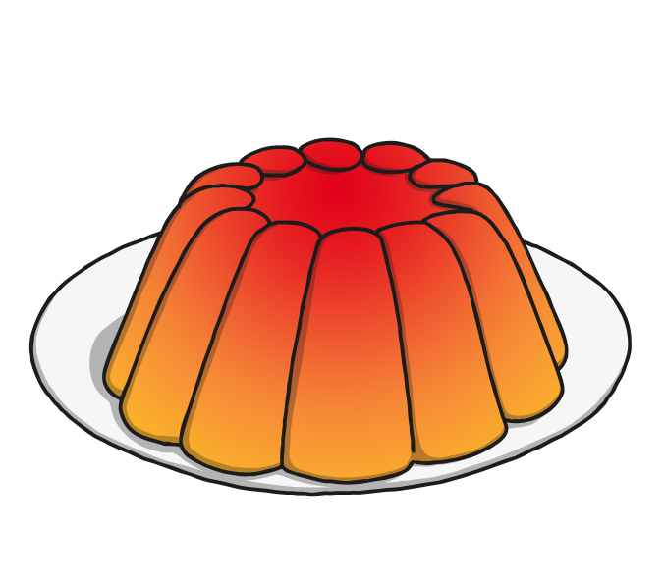
j

Slide 28
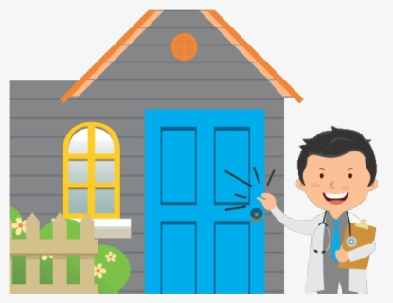
Our phoneme today is…
visit
v
volcano
Can you say these words with our phoneme in?

Slide 29
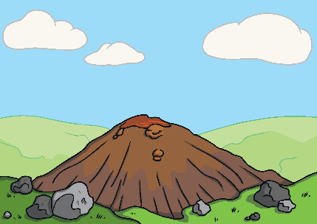
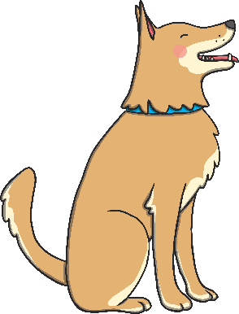
Click the pictures that begin with ‘v’ to move them into the middle.
v

Slide 30
Have a go at writing these words:
Can you think of any more words with a ‘v’? Remember, it doesn’t have to be at the start of the word.

