Slide 1
The Rhythm of Life Advent Journey
Praying

Slide 2
Celebration 1
Have a thoughtful look at these images.
What do they stand for?

Slide 3
Celebration 1
Why do you think people post things on social media?
How does being listened to or noticed make you feel?
What do they stand for?

Slide 4
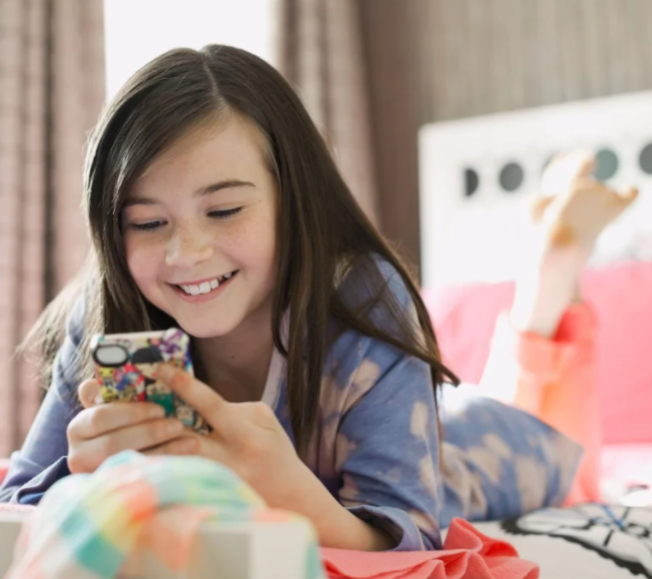
Celebration 1
Something that went well
Something you are worrying about
Something that is going to happen
Something you are hoping for
Something you did wrong
Something that went badly
If your best friend was away, what would you want to tell them about?
Something you wished you could change

Slide 5
Celebration 1
A thought to take away…
Christians believe that God loves to listen to us. We don’t need a phone or computer. And we don’t have to say formal, ‘grown up’ prayers.
When we pray, we can just chat to God and tell him about our day, the successes and the failures, our hopes for the future, our mistakes. We can tell him about all of it, knowing that he has promised to hear us. And when we do, we may start to notice his answers in our lives.

Slide 6
Celebration 1
Today’s Challenge
If you would like to join in with today’s challenge,
why don’t you:
Chat to God today. Tell him how you feel about the things that happen as you go through your day.
or
Someone Else
Thanks
Draw round your hand. Make and pray a ‘prayer hand’.
Pray for someone else
Thank God for something good from your day
Say sorry for something you did wrong
Share a worry or thought with God
Ask for God’s help
Sorry
Share
Please

Slide 7
Celebration 1
If you would like to, you can join in saying these prayers.
A Prayer for the Day
The Rhythm of Life Prayer
Dear Jesus, my loving friend,
Thank you that you care about me, about my day, about my worries and my wishes.
Thank you that you notice me and listen to me.
Thank you that you hear my prayers and love to answer.
Amen
Loving God,
Help us to learn from you
the habit of praying,
so that the rhythm of our lives can match
the rhythm of your heart of love.
Amen

Slide 8
This resource was produced by the Diocese of Leeds Education Team.
For more information about this or future resources,
please contact your named adviser:
simone.bennett@leeds.anglican.org
simon.sloan@leeds.anglican.org
darren.dudman@leeds.anglican.org
janet.tringham@leeds.anglican.org
lee.talbot@leeds.anglican.org
rupert.madeley@leeds.anglican.org

