Slide 2
What do we know about Claude Monet?
What was his style?
Which were his famous paintings?

Slide 3
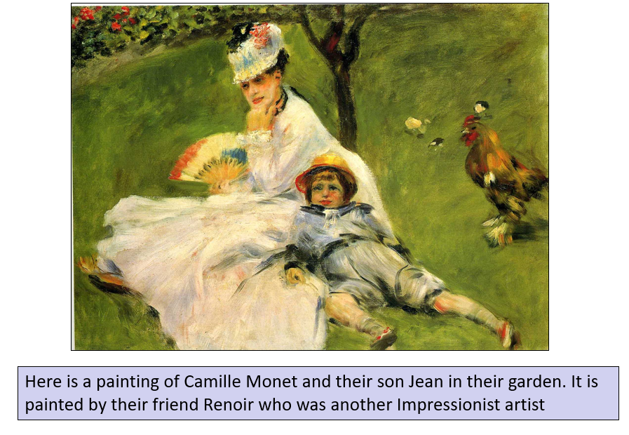

Slide 4
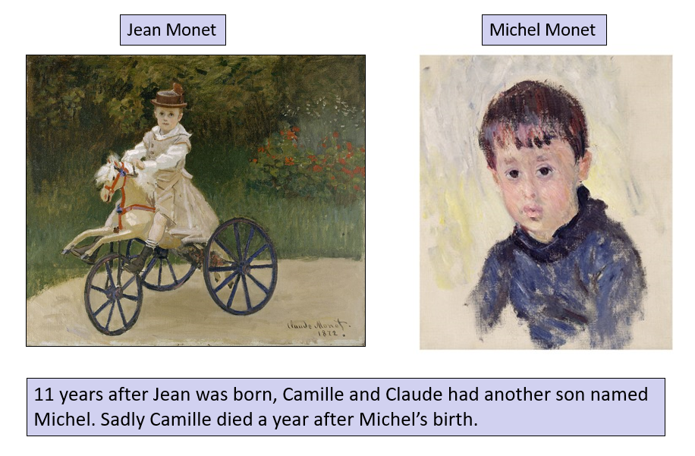

Slide 5
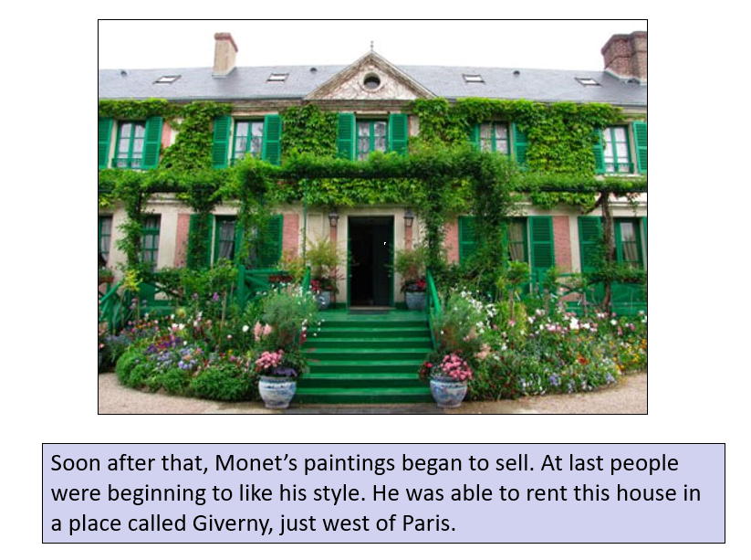

Slide 7
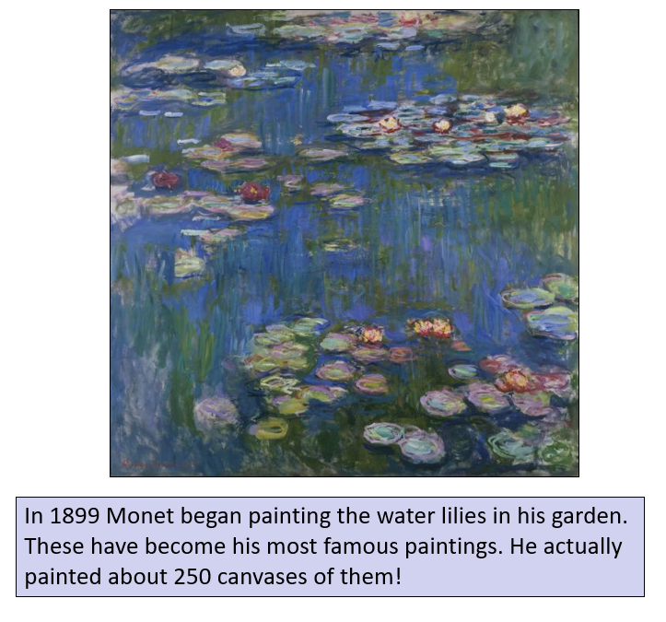

Slide 8
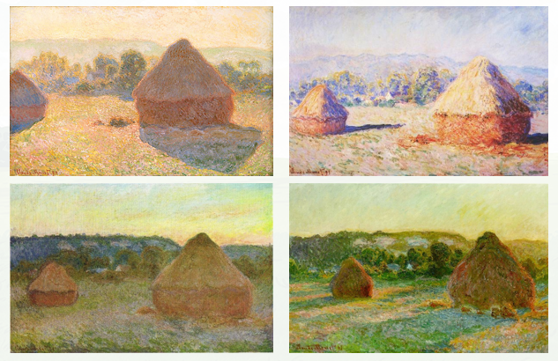
The Haystacks

Slide 9
Your task today is to create a painting in the style of Monet.
The Haystacks painting will be your stimulus.

Slide 10
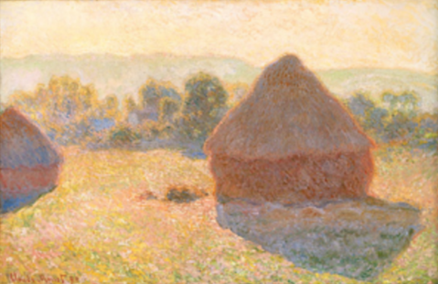
What do we know about the style of Monet?

Slide 11
Think about how to mix and match your colours carefully and remember to use loose brushstrokes.
In an ideal world, it would be great to use acrylic paint as it is similar to oil but dries quicker, but as always, just use whatever you have available to you at home.
It is a good idea to begin with a rough pencil sketch of the main outlines that can be seen in the picture - but don’t include any detail.
Use the picture as your stimulus and copy it the best you can.

Slide 12
How to paint like Monet:
1. On your drawing paper, use your watercolour paints to create the lighter background features (e.g. sky).
2. Darken your watercolour mix and add the shading, where necessary. Think about how this changes the moment.
3. Use your oil pastels (or crayons) to add in the features in the foreground (e.g. bridges, trees, boats, etc.) Consider how the colour of these subjects is impacted by light/atmosphere.
4. Once your piece is complete, try to paint the same subject in a different moment (using your photos). How can you change the light/ atmosphere?

Slide 13
Look at your painting.
Have you successfully shown the mood of the painting?
Have you captured the colour/light of the sky?
Do they give an impression?

