Slide 1
Class 4 Residential
Kingswood, Dearne Valley.
20 minutes from Doncaster in the South Yorkshire.

Slide 2
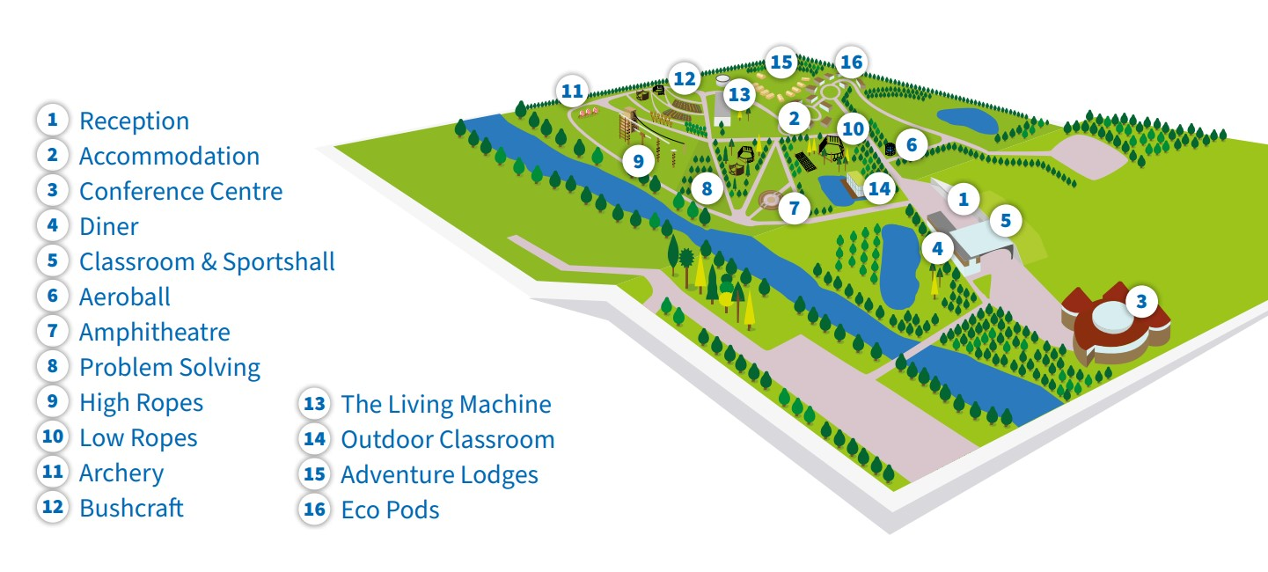

Slide 3
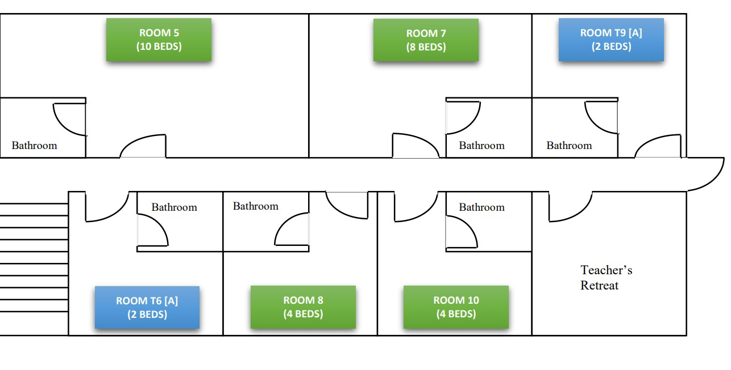
Room Allocations
Mrs Glover and Mrs Draper
Year 5 girls
Mixture of Year 5 and 6 boys
Mrs Acheson
Year 6 girls
OC, ET, SC

Slide 4
Wednesday
Time | Activity
9am | Children to arrive in school as normal
Morning | Games and pre residential activities
1pm (approx.) | Depart from Fountains
2.30pm | Arrival at Kingswood/Meet Course Director
3.15pm | Dorming
4pm | Jacobs Ladder and Vertical Play Pen
5.30pm | Group Contract, Dinner and Mini Olympics
9pm | Return to dorms

Slide 5
Thursday
Time | Activity
 | Breakfast
9.15am | Problem Solving, Aeroball and Laser
12.15pm | Get Connected and Lunch
2.30pm | Archery
4pm | Vertical Play Pen and Jacobs Ladder
5.30pm | Trip Reflection, Dinner and Campfire
9pm | Return to dorms

Slide 6
Friday
 | Activity
 | Breakfast
9.15am | Zipwire
10.45pm | Buggy Build
 | Lunch
1.30pm | Departure
3pm (approx.) | Arrival back at Fountains (children can be collected at the normal time)

Slide 8
Kingswood
To find out more about Kingswood you can visit their website: www.kingswood.co.uk.

