Slide 3
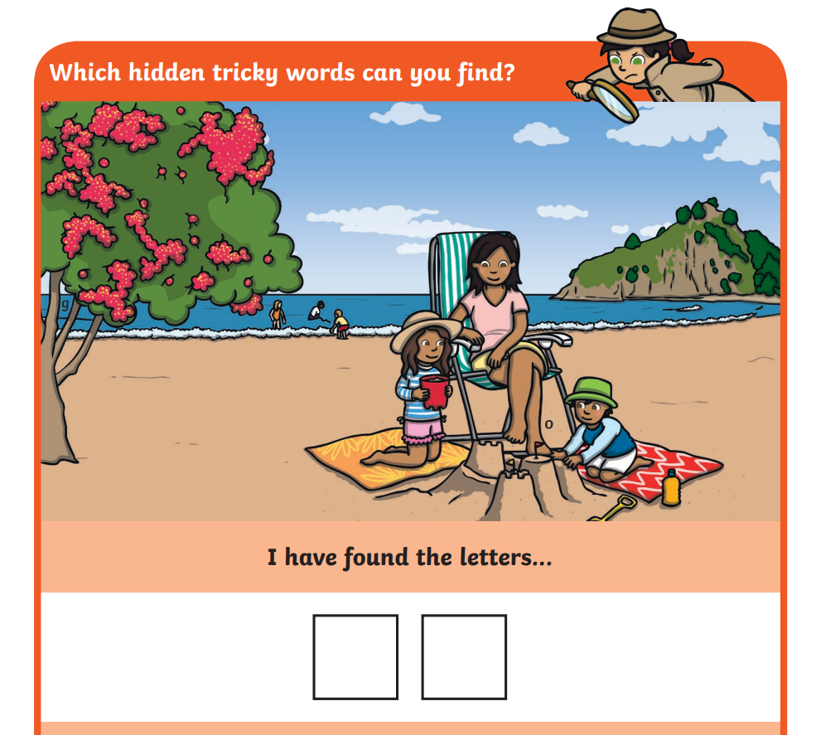

Slide 4
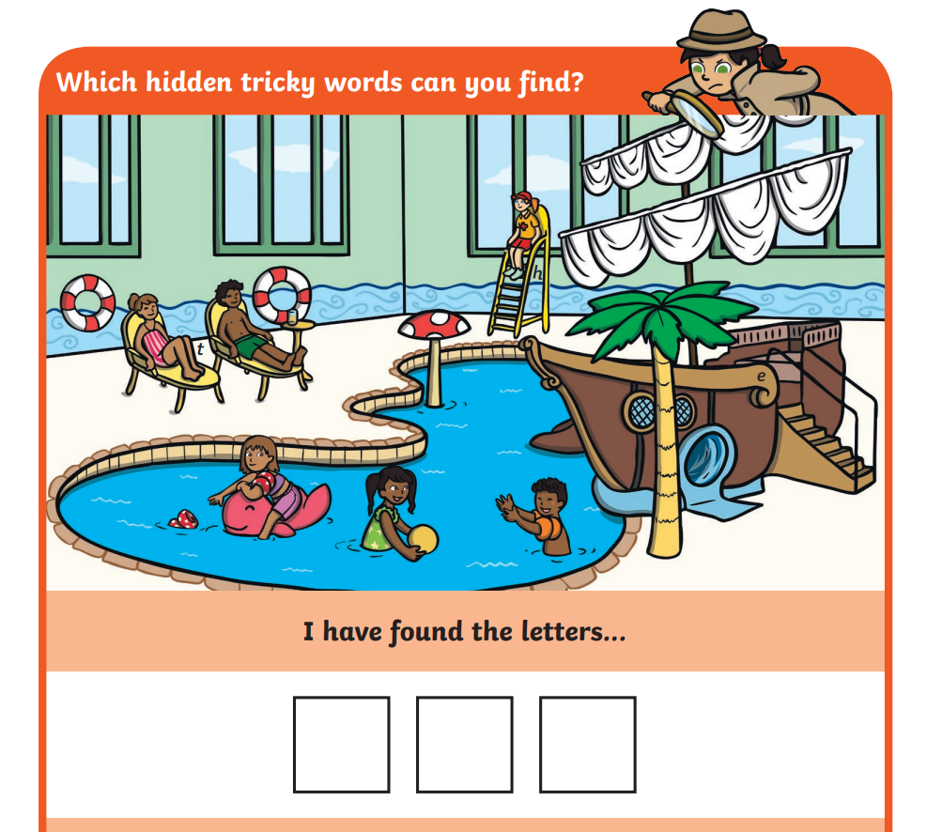

Slide 5
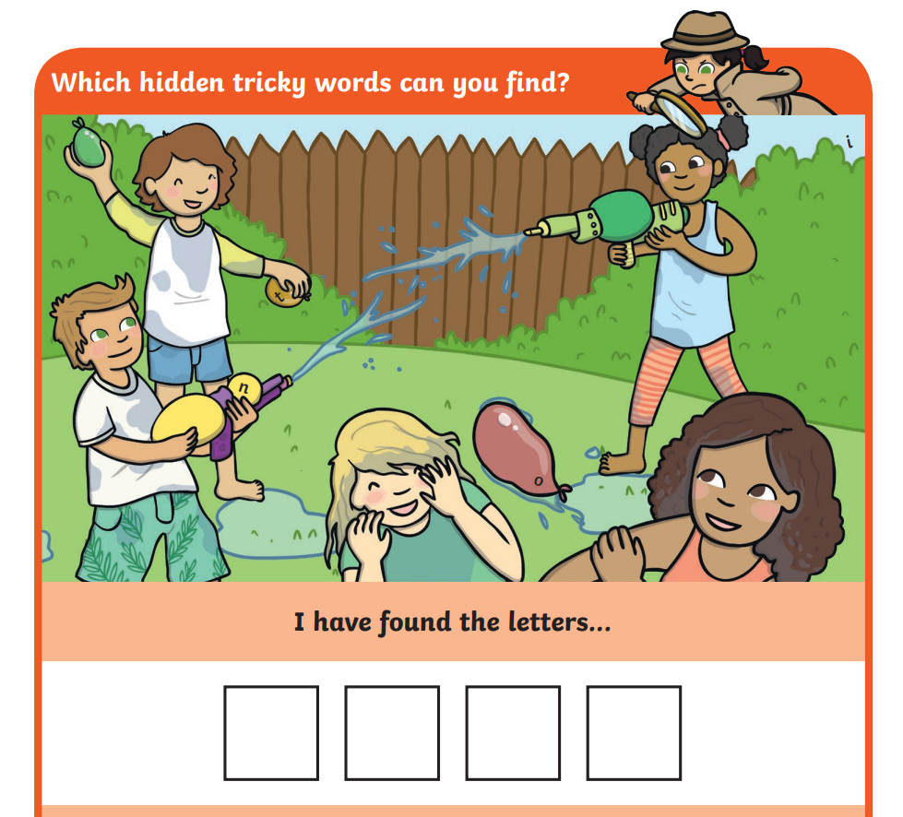

Slide 6
Choose one of these games to practice your phonics
Build a man/ hangman
Use lines to represent a letter, have children guess a letter. If it is in the word write in the correct space, if not in the word, begin to draw a stick man.
Bingo
Make a bingo card using the words, using the set of cards pick the cards up and if the word is read correctly a counter can be placed over the word.
Pelmanism
Place the cards face down in random order. Take turns to pick up two cards, if they match and are read correctly he/ she can keep the cards.
Colour coding
Write the words on a piece of paper/ card. Give an instruction e.g. ‘colour the word “said” blue’, ‘colour the word “you” red’ etc.

Slide 7
Flashcard Activities
Create flashcards for the tricky words, put them around the house to find and read.
Louder and Louder:
Begin reading the words on the word wall in a whisper. As they go along, have them gradually increase the volume until they are shouting by the last word.
Funny Voices:
Flash the cards to students, and have each student read a word in a robot voice, an old voice, a squeaky voice, and a monster voice.
Swat!:
Stick the words to the wall. Have a flyswatter or water pistol (if outside). Read a word from the word wall. Swat the correct word to get a point.

