Slide 1
Fountains C E School 2021
Information for children and parents about Fountains CE School.

Slide 2
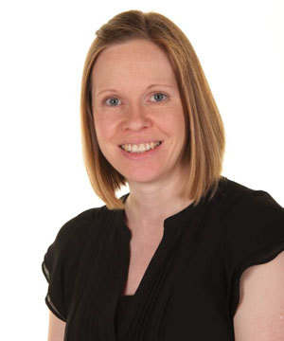
Meet the school staff
Miss Wray is your class teacher. She will be there to meet you at the door each morning.
The children in reception class will only be allowed to go home with a named adult so if there is a change to the normal routine, please let us know.
If parents need to talk to Miss Wray, you can email me at class1@gfschools.co.uk or please contact the school office to arrange an appointment.

Slide 3
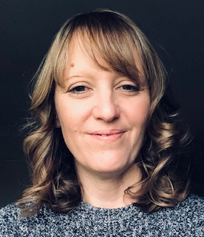
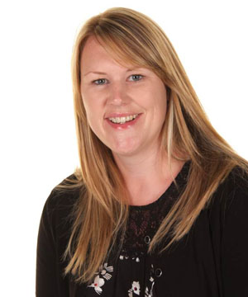
Our Headteacher…
Mrs Acheson is our Headteacher, she is the headteacher across the federation of Grewelthorpe and Fountains schools. She often pops into class to say hello!
Mrs Barker is the teacher in charge at Fountains when Mrs Acheson is at Grewelthorpe.

Slide 4
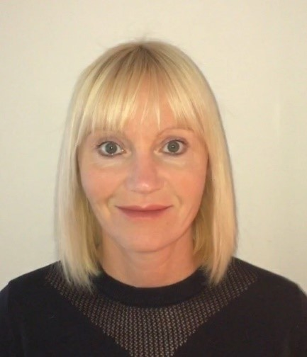
In the office…
Mrs Mallinson is our office manager. She is often the first point of contact for any questions you may have.
We use ParentPay for all payments – after school clubs, trips, fundraising events, school lunches etc

Slide 5
First aid
If you hurt yourself at school there will always be someone who is a trained first aider on hand to help.
If your child injures themselves at school you will receive an email to let you know what happened and how they are. If it is a more serious injury, you will receive a phone call straight away.

