Slide 1
The Rhythm of Life
Pentecost

Slide 2
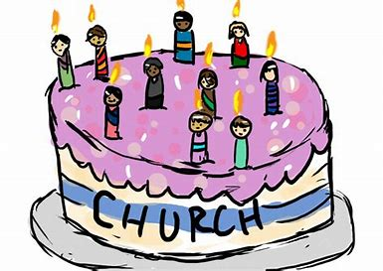
Pentecost
Christians say this special day is the
‘Birthday of the Church’.
What do you think might happen?
Christians get a special gift. What might
it be?

Slide 3
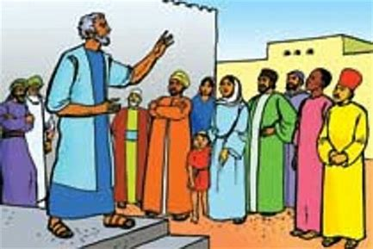
This is how the story starts…
After Jesus rose again at Easter his friends got very used to having him there. Now they were on their own again because the Bible says he had gone back to heaven.
How do you think they are feeling?

Slide 4
But Jesus had a plan to help them…before he died he told them:
John - Chapter 14
I will ask the Father, and he will give you another Helper to be with you forever… this Helper is the Holy Spirit…

Slide 5
Listen to what the Bible says happened next…
Acts - Chapter 2
When the day of Pentecost came, they were all together. ² Suddenly a noise came from heaven. It was like a strong wind blowing… They saw something that looked like flames of fire… They were all filled with the Holy Spirit, and began to talk in different languages.

Slide 6
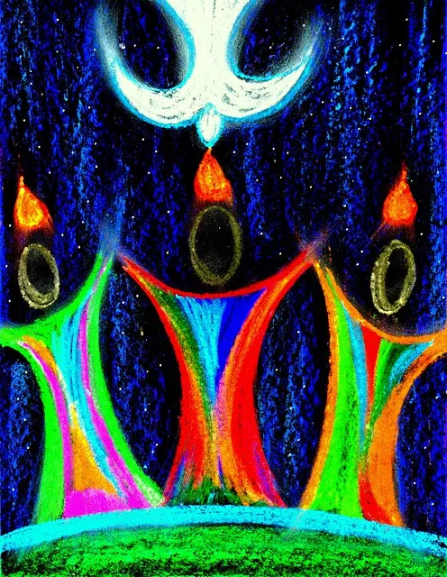
What a strange thing to have happened! Is that what you expected?
But afterwards, the friends of Jesus felt much better. This special gift called the Holy Spirit told them that God was with them wherever they went….
When it was easy…
When it was hard…
They used the special languages and went all over the world to tell everyone else about Jesus.
Because of that, there are Christians all over the world today and the Church was started – that’s why it’s a birthday!

Slide 7
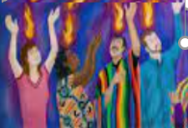
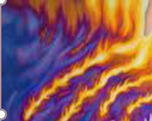
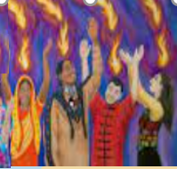
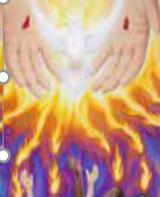
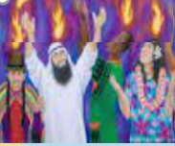
What a strange event Pentecost must have been!
This picture reminds us of the story.
Can you help move the pieces to put it back together?

Slide 8
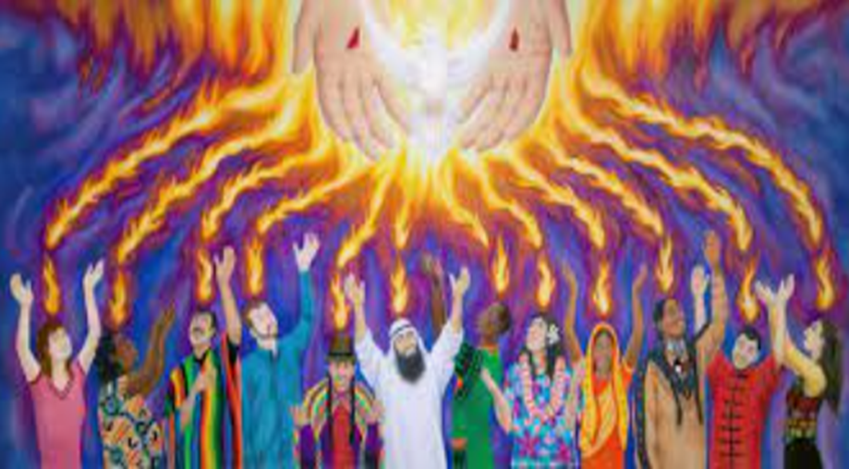
Well done!
The church often uses pictures of flames and doves to remind them of the story of Pentecost.

Slide 9
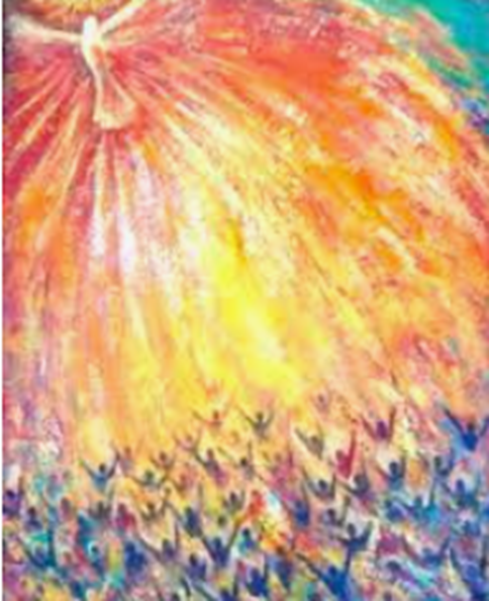
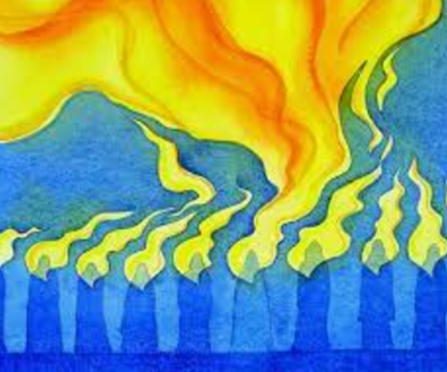
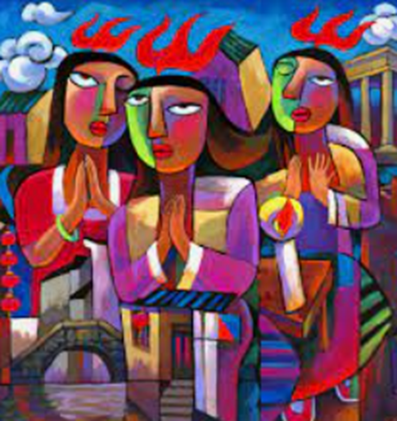
Today you could:
Help someone who is finding something hard?
Or
Here are some other pictures about Pentecost. Can you draw your own?

Slide 10
Listen to this special prayer. If you want to make it your prayer too,
you can say Amen at the end.
A Prayer for the Day
Holy Spirit,
Thank you for the first Pentecost.
Thank you that you are happy to help us and guide us too.
Amen

Slide 11
The Rhythm of Life
Pentecost
simone.bennett@leeds.anglican.org
simon.sloan@leeds.anglican.org
darren.dudman@leeds.anglican.org
janet.tringham@leeds.anglican.org
lee.talbot@leeds.anglican.org
rupert.madeley@leeds.anglican.org
This resource was produced by the Diocese of Leeds Education Team.
For more information about this or future resources, please contact your named adviser:

