Slide 1
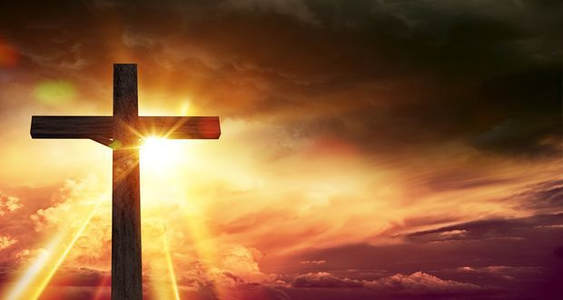
Was Jesus the Messiah?

Slide 2
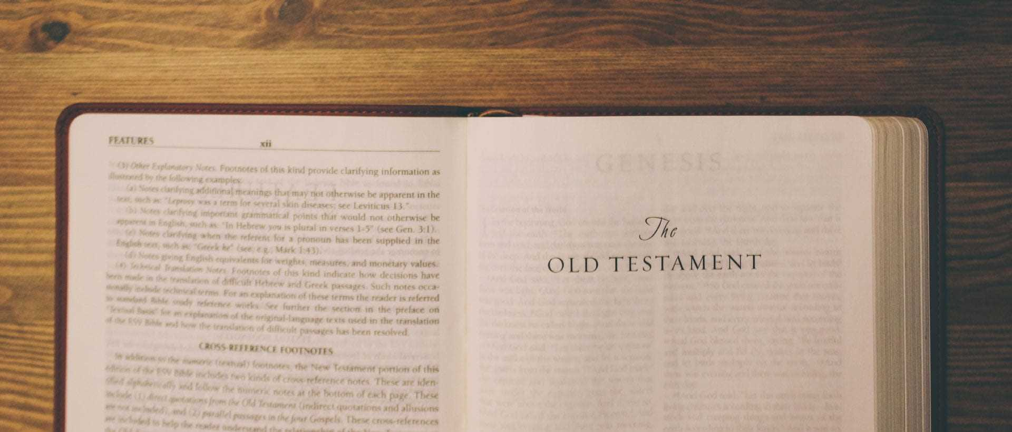
LI: To understand the place of Incarnation and Messiah within the ‘big story’ of the bible.
LI: To identify Gospel and prophecy texts, using technical terms.

Slide 3
What do we know about the big story of the Bible so far?

Slide 4
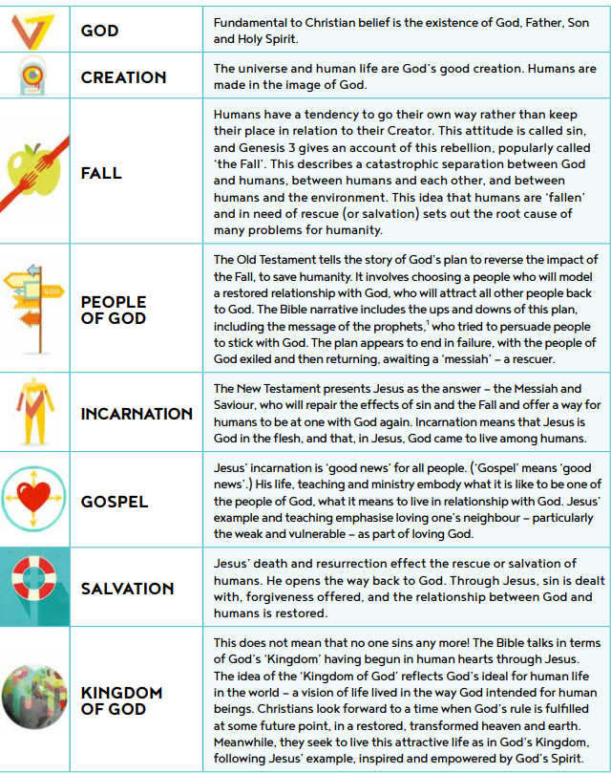

Slide 5
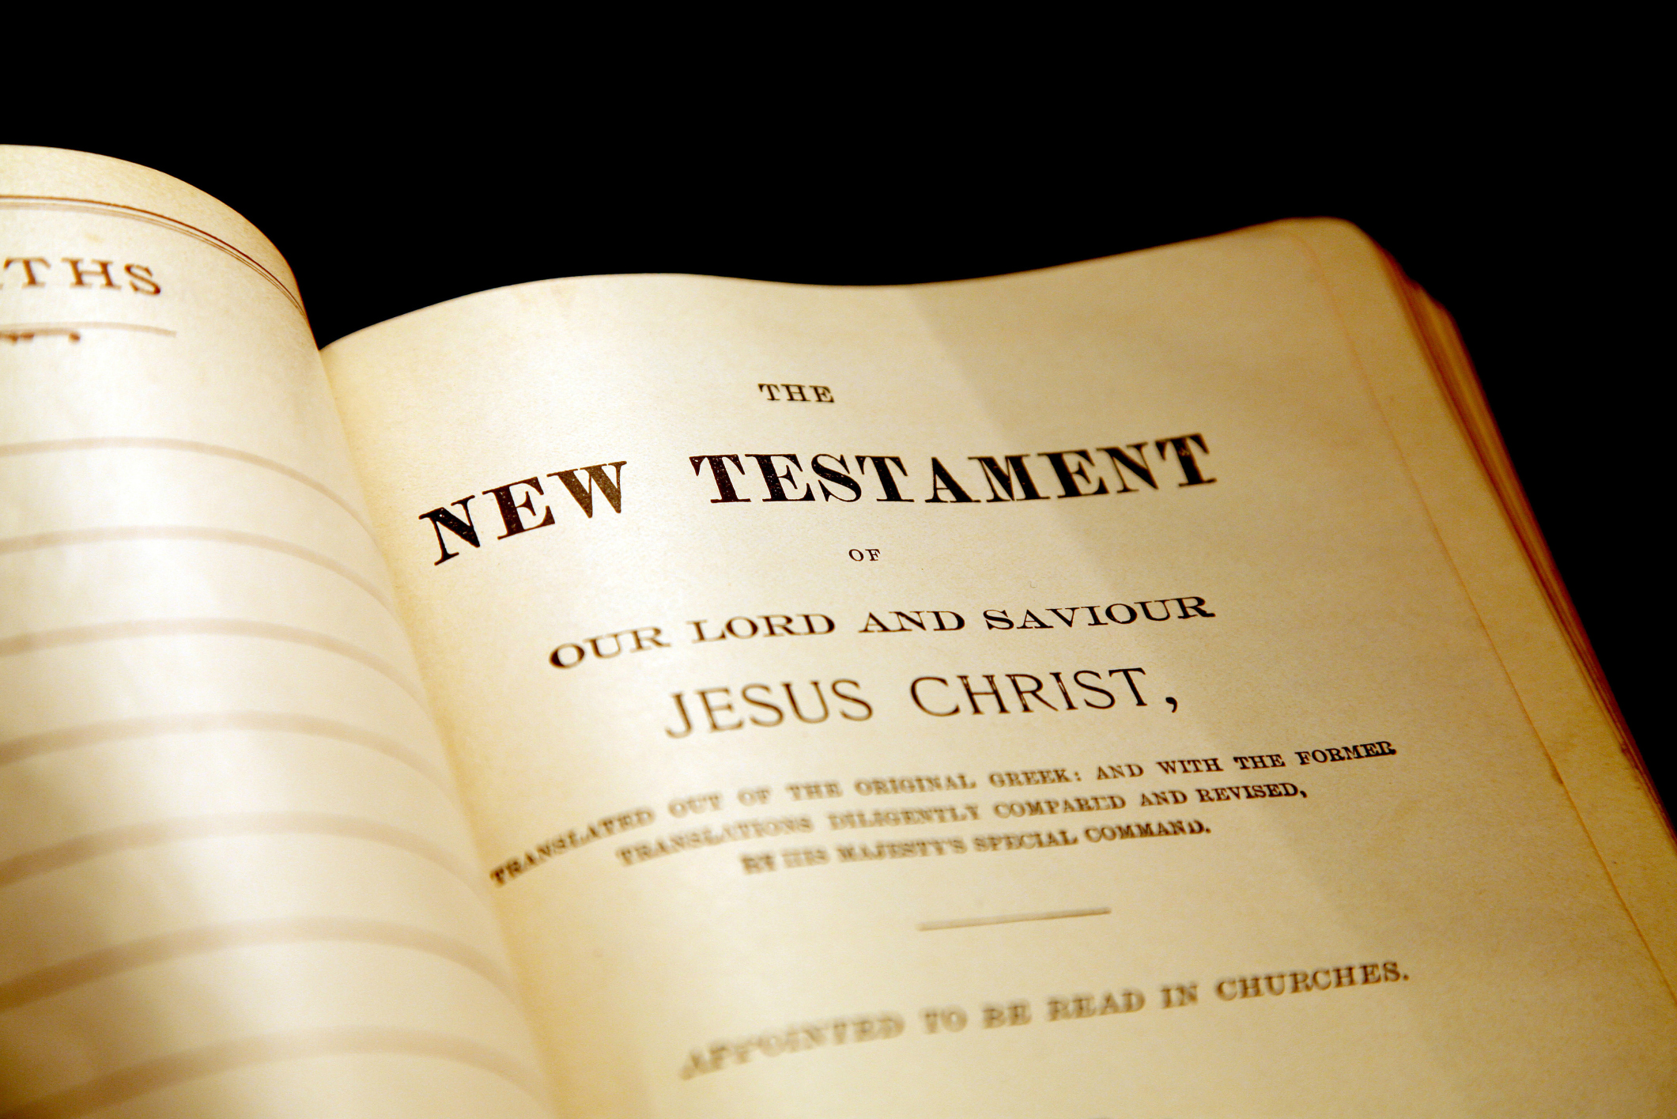
We are going to be looking at the New Testament, but to start with, we need to look at the end of the Old Testament.

Slide 6
What do we mean about being a Saviour or a Messiah?
What is one of these?
Can we define?

Slide 7
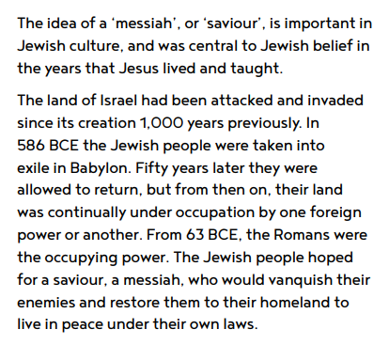
What was happening in 586BCE?
What were the Jewish people hoping for and why?

Slide 8
Today, we're going to try to answer the question...
Was Jesus the hoped-for Saviour? Was Jesus the Messiah?
We are going to use texts to try to answer this question.

Slide 9
What characteristics do you think a Messiah should have?

Slide 10
What is a prophecy?
A prediction of what will happen in the future.
What is a Gospel?
The teaching or revelation of Christ.

Slide 11
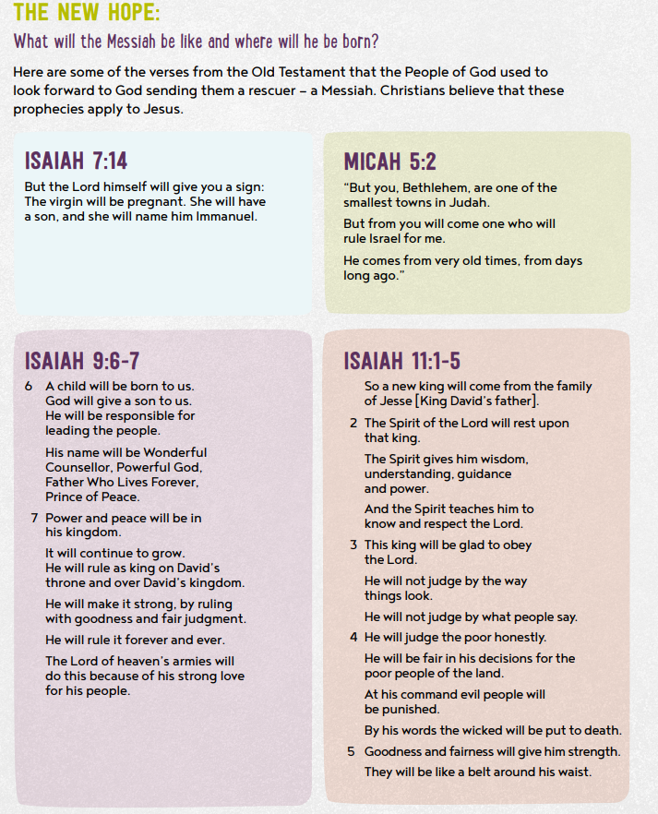

Slide 13
I would like you to create a wanted poster for the Messiah based on the Jewish expectations (on the previous slide).
Try to make a link to each of the expectations. For example...
him wearing a crown/ holding a family tree with King David marked on it/ birth certificate with place of birth as Bethlehem, and so on.

Slide 14
It would be great if you could send me your poster so that I can see what you’ve done.
If you’ve created your poster on a computer you can upload it to Teams, or you could photograph it and send a photo of it to me at class4@gfschools.co.uk

