Slide 1
Can you remember our tricky words so far?

Slide 2
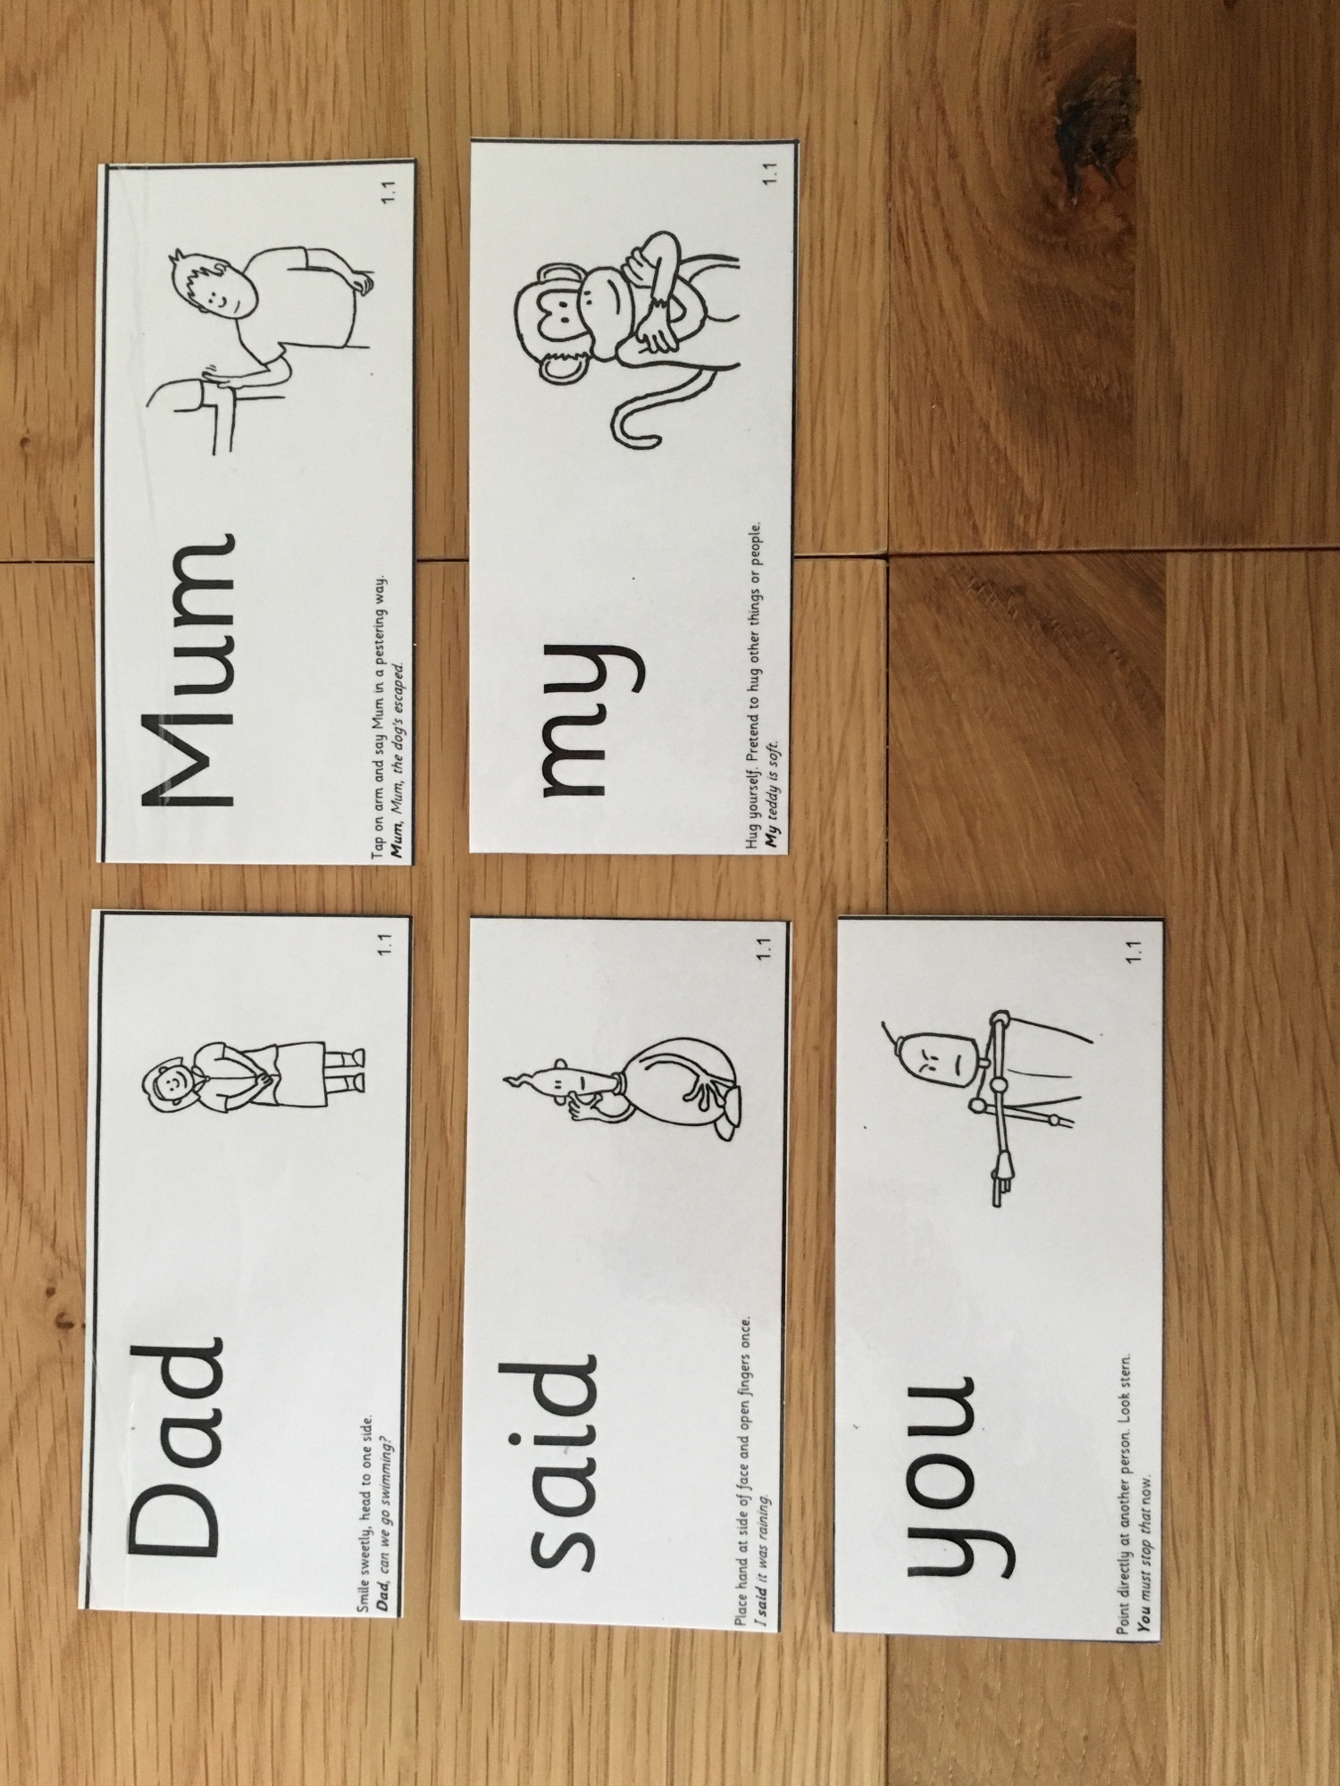

Slide 5
Look at our new tricky words…
into

