Slide 1
Fountains C E School 2021
Information for children and parents about Fountains CE School.

Slide 2
Welcome to Class 1
Welcome to our Reception class, we would like to share some information to help you as you get ready to start school.

Slide 3
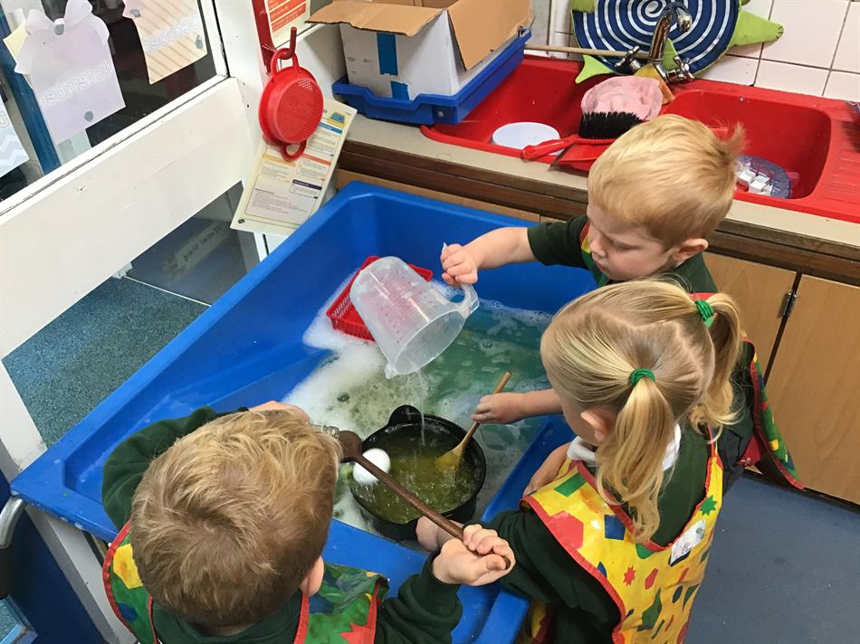
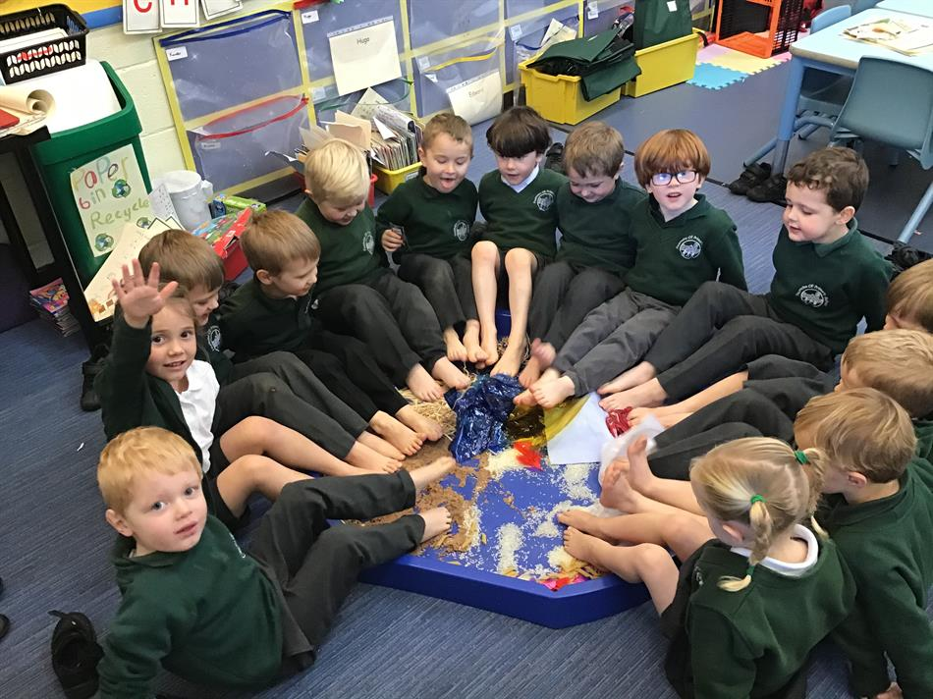
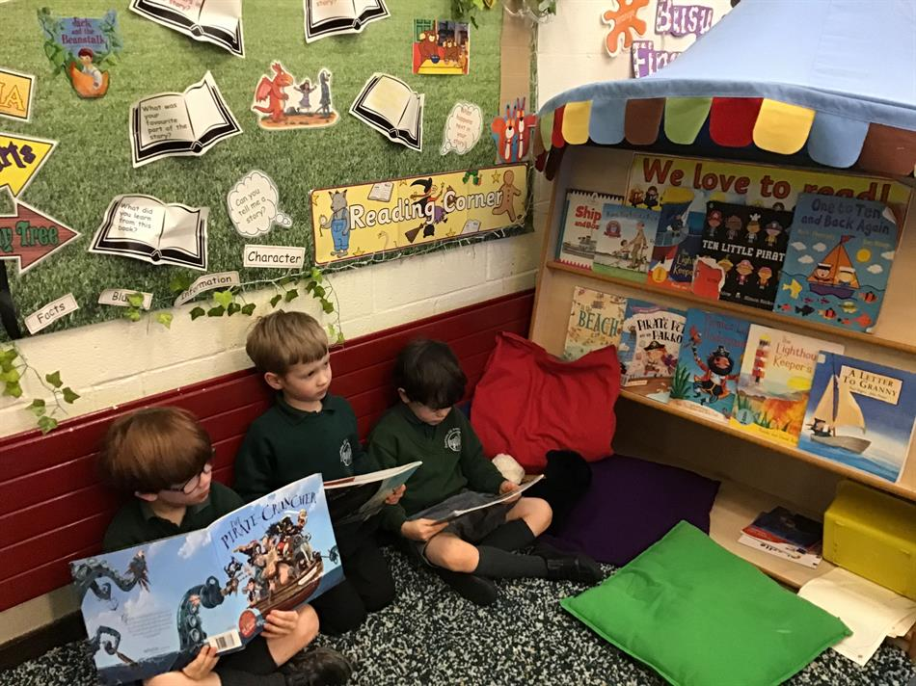
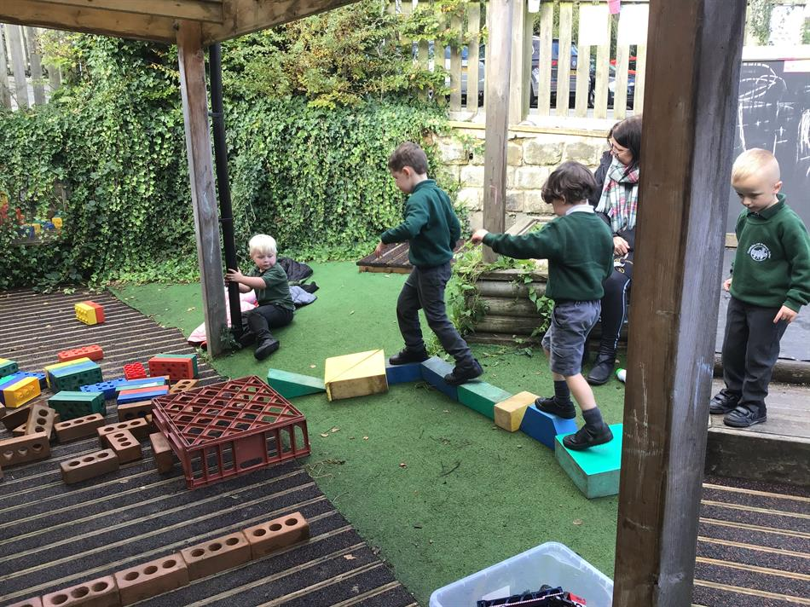
Effort, Aspiration, Respect and Responsibility
In Class 1, we love to learn in different ways. We do lots of different activities in our classroom!

Slide 4
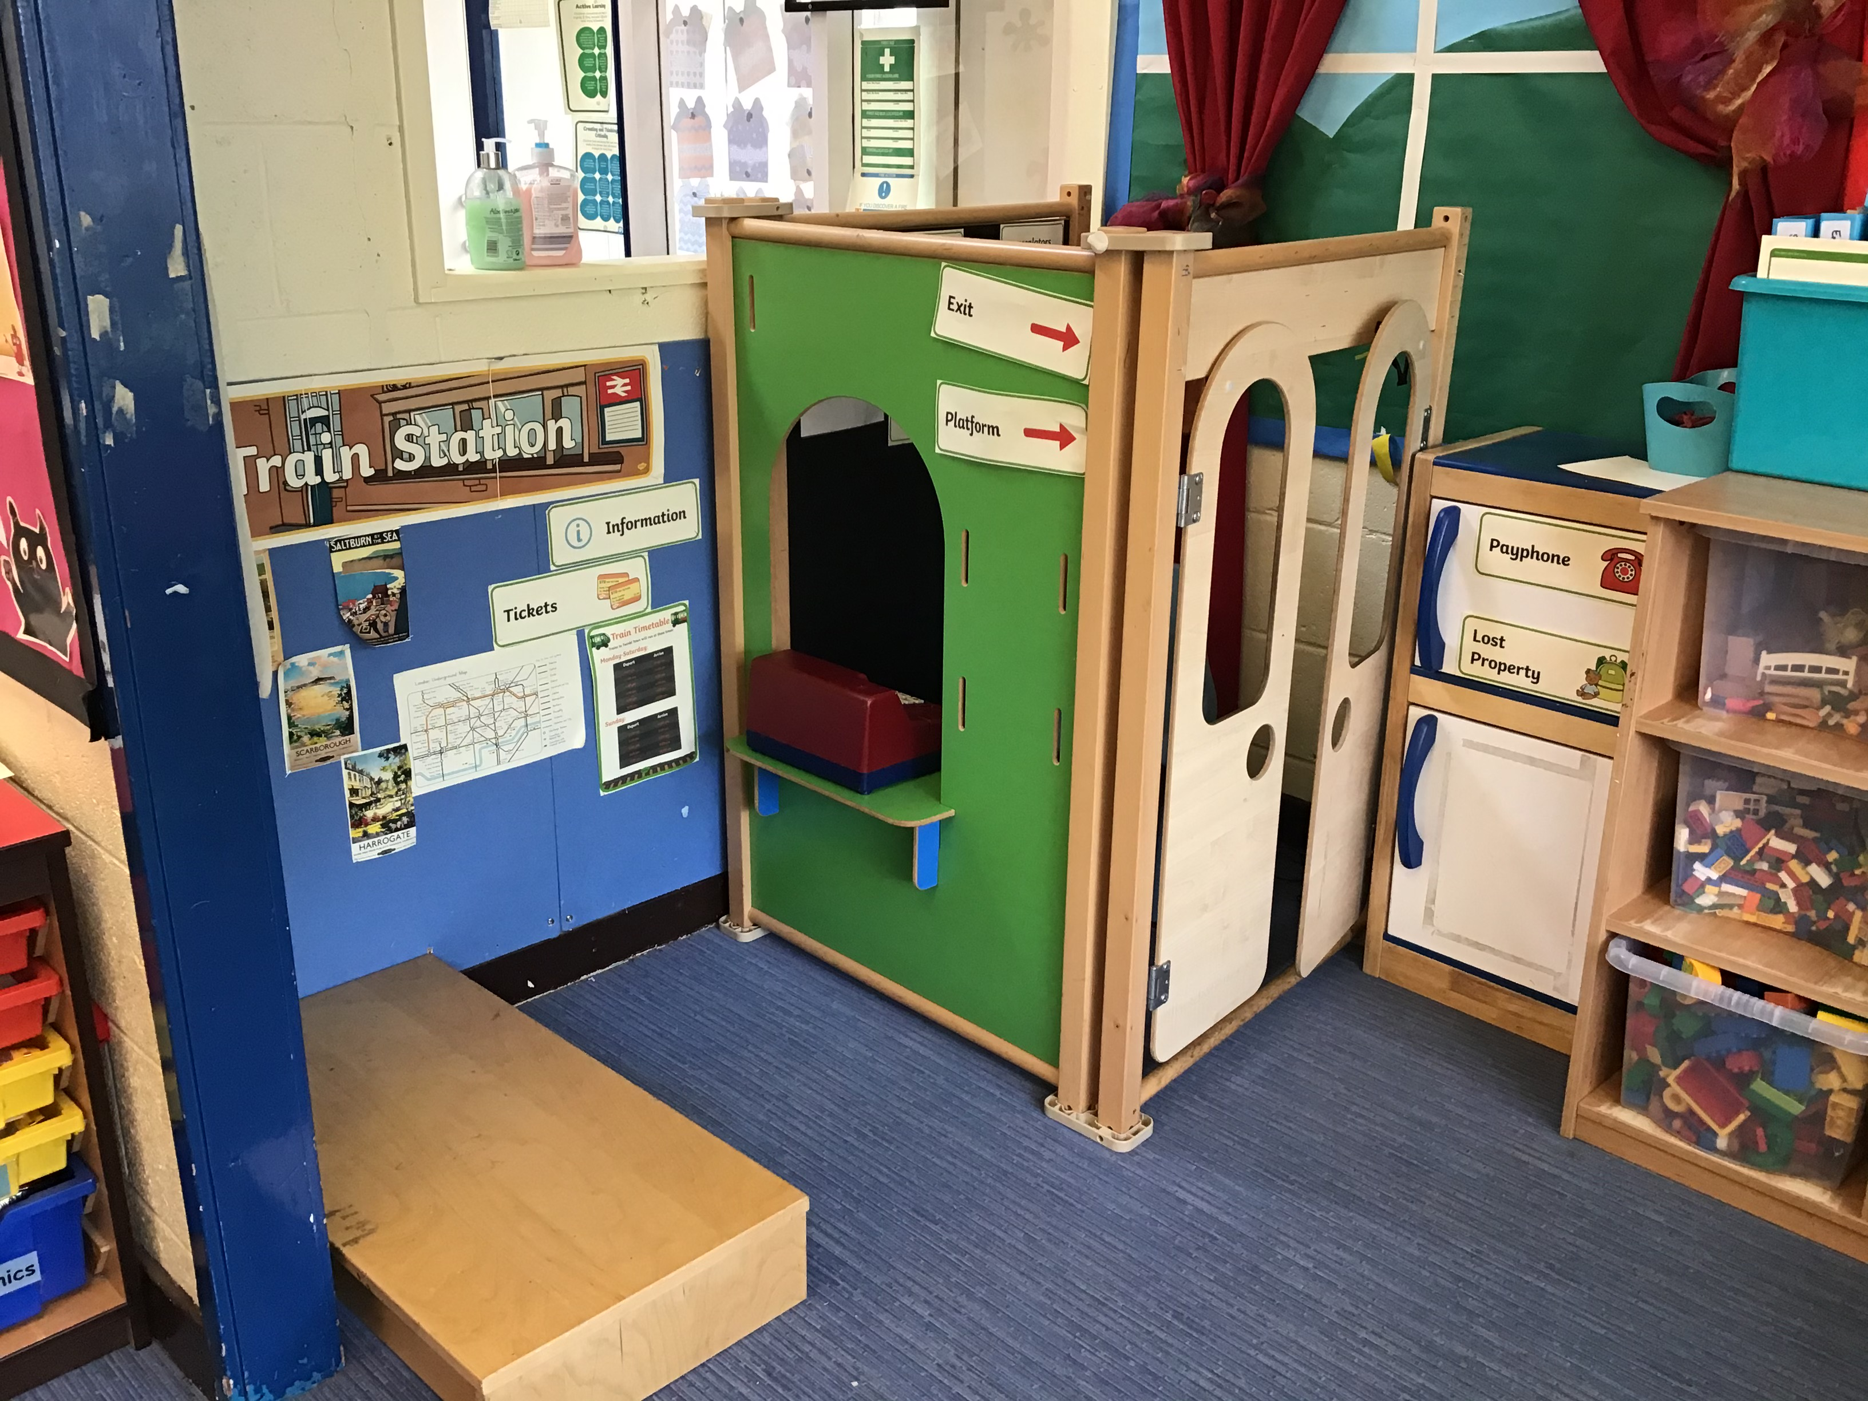
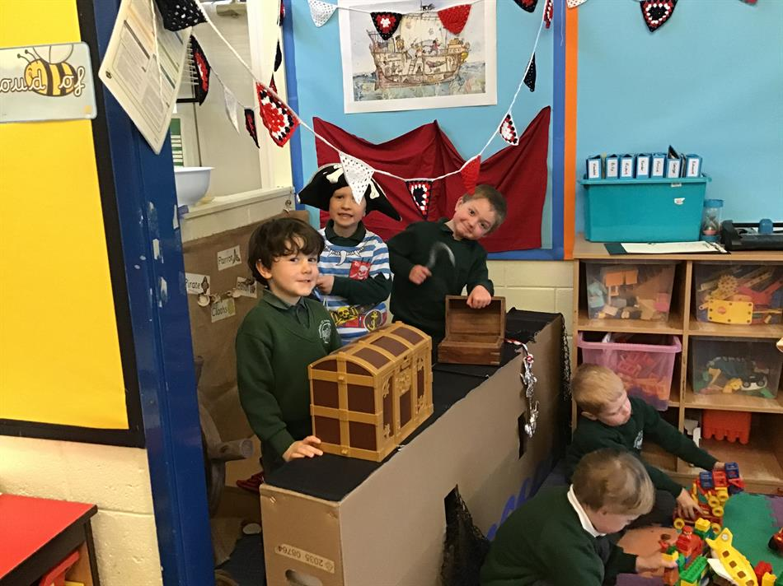
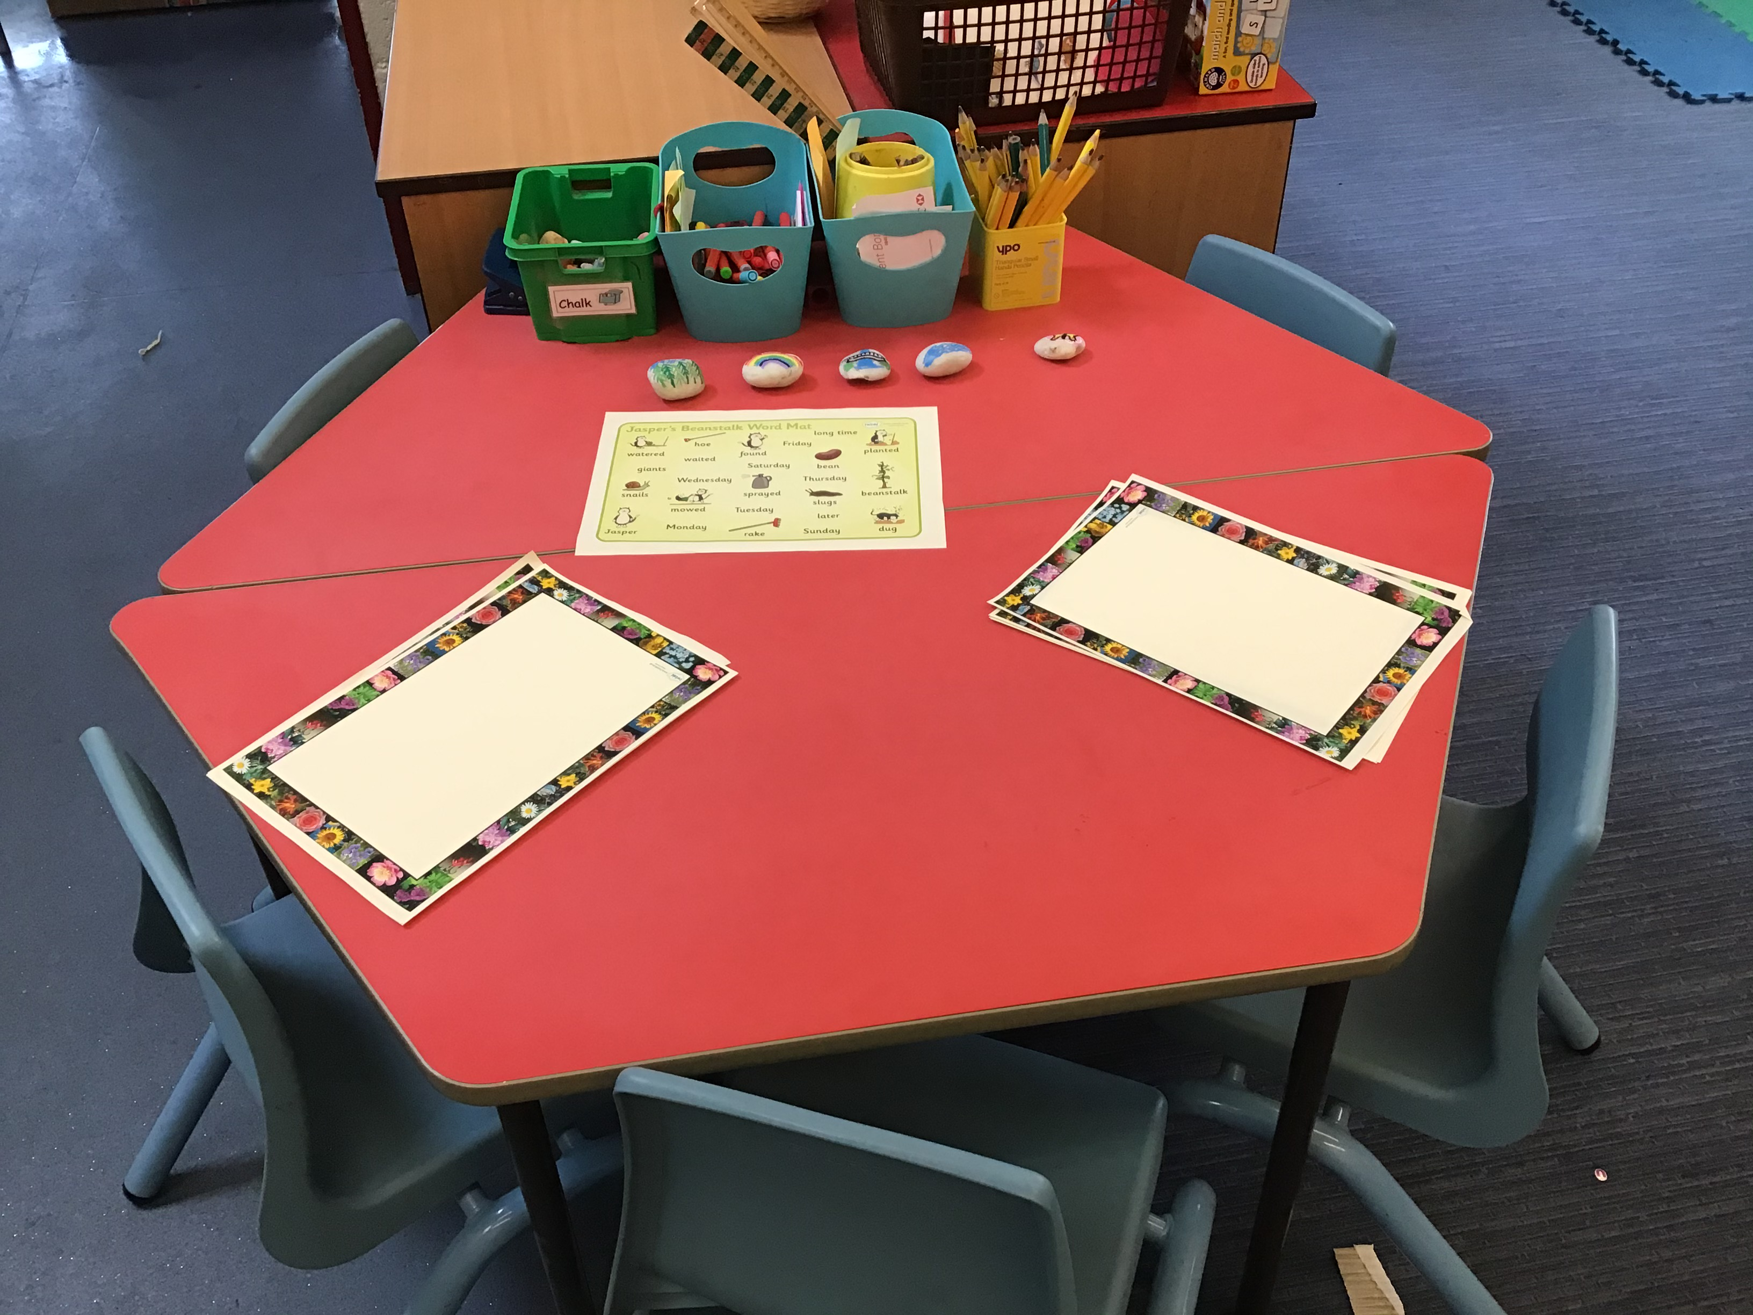
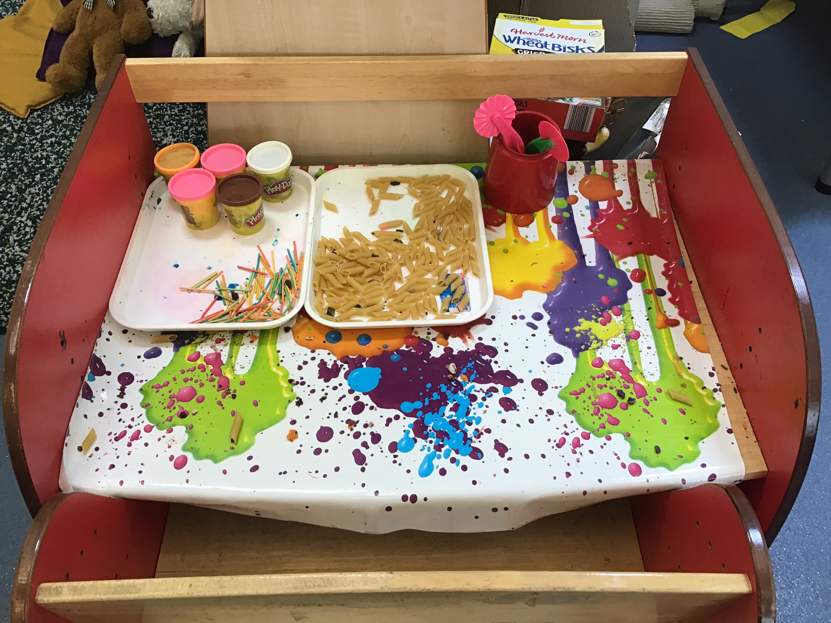
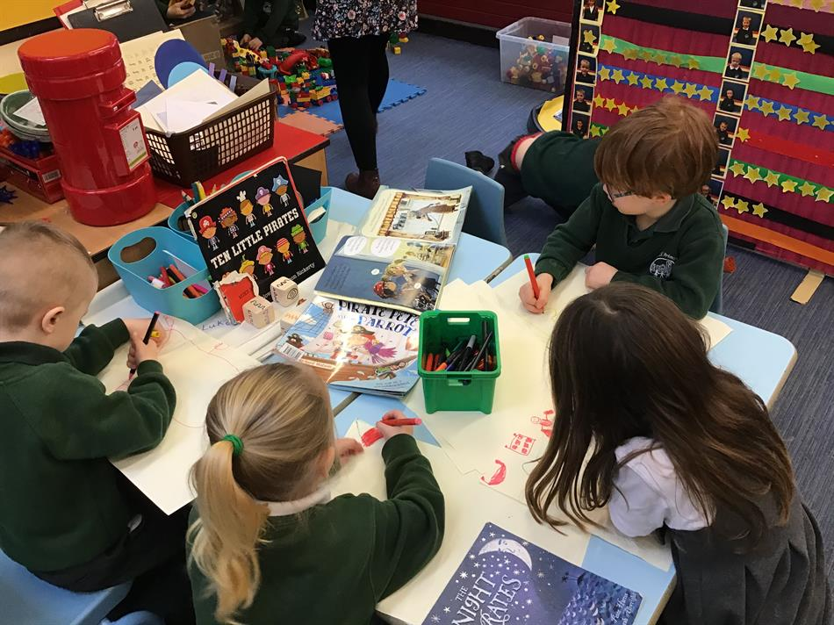
Our indoor classroom…
There are always lots of things to explore in our classroom. We work as a whole class, in small groups or on our own.
Our role play area is set up following our current theme or the children’s interests.
We have a message centre and funky fingers table to help develop our fine motor control.

Slide 5
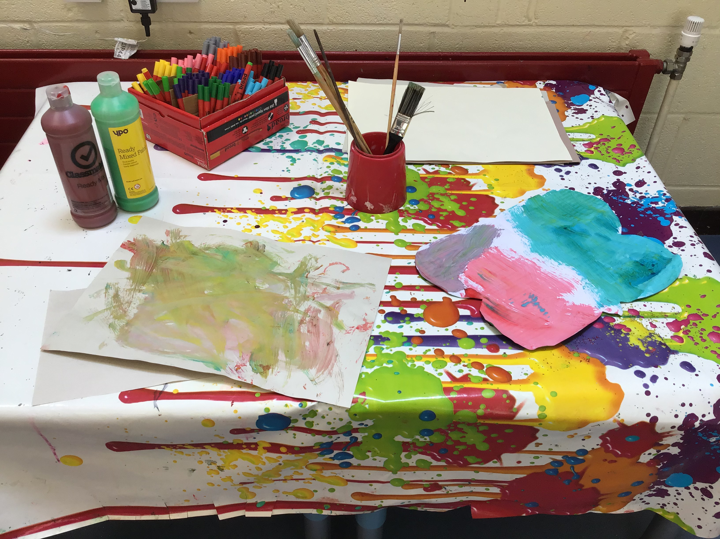
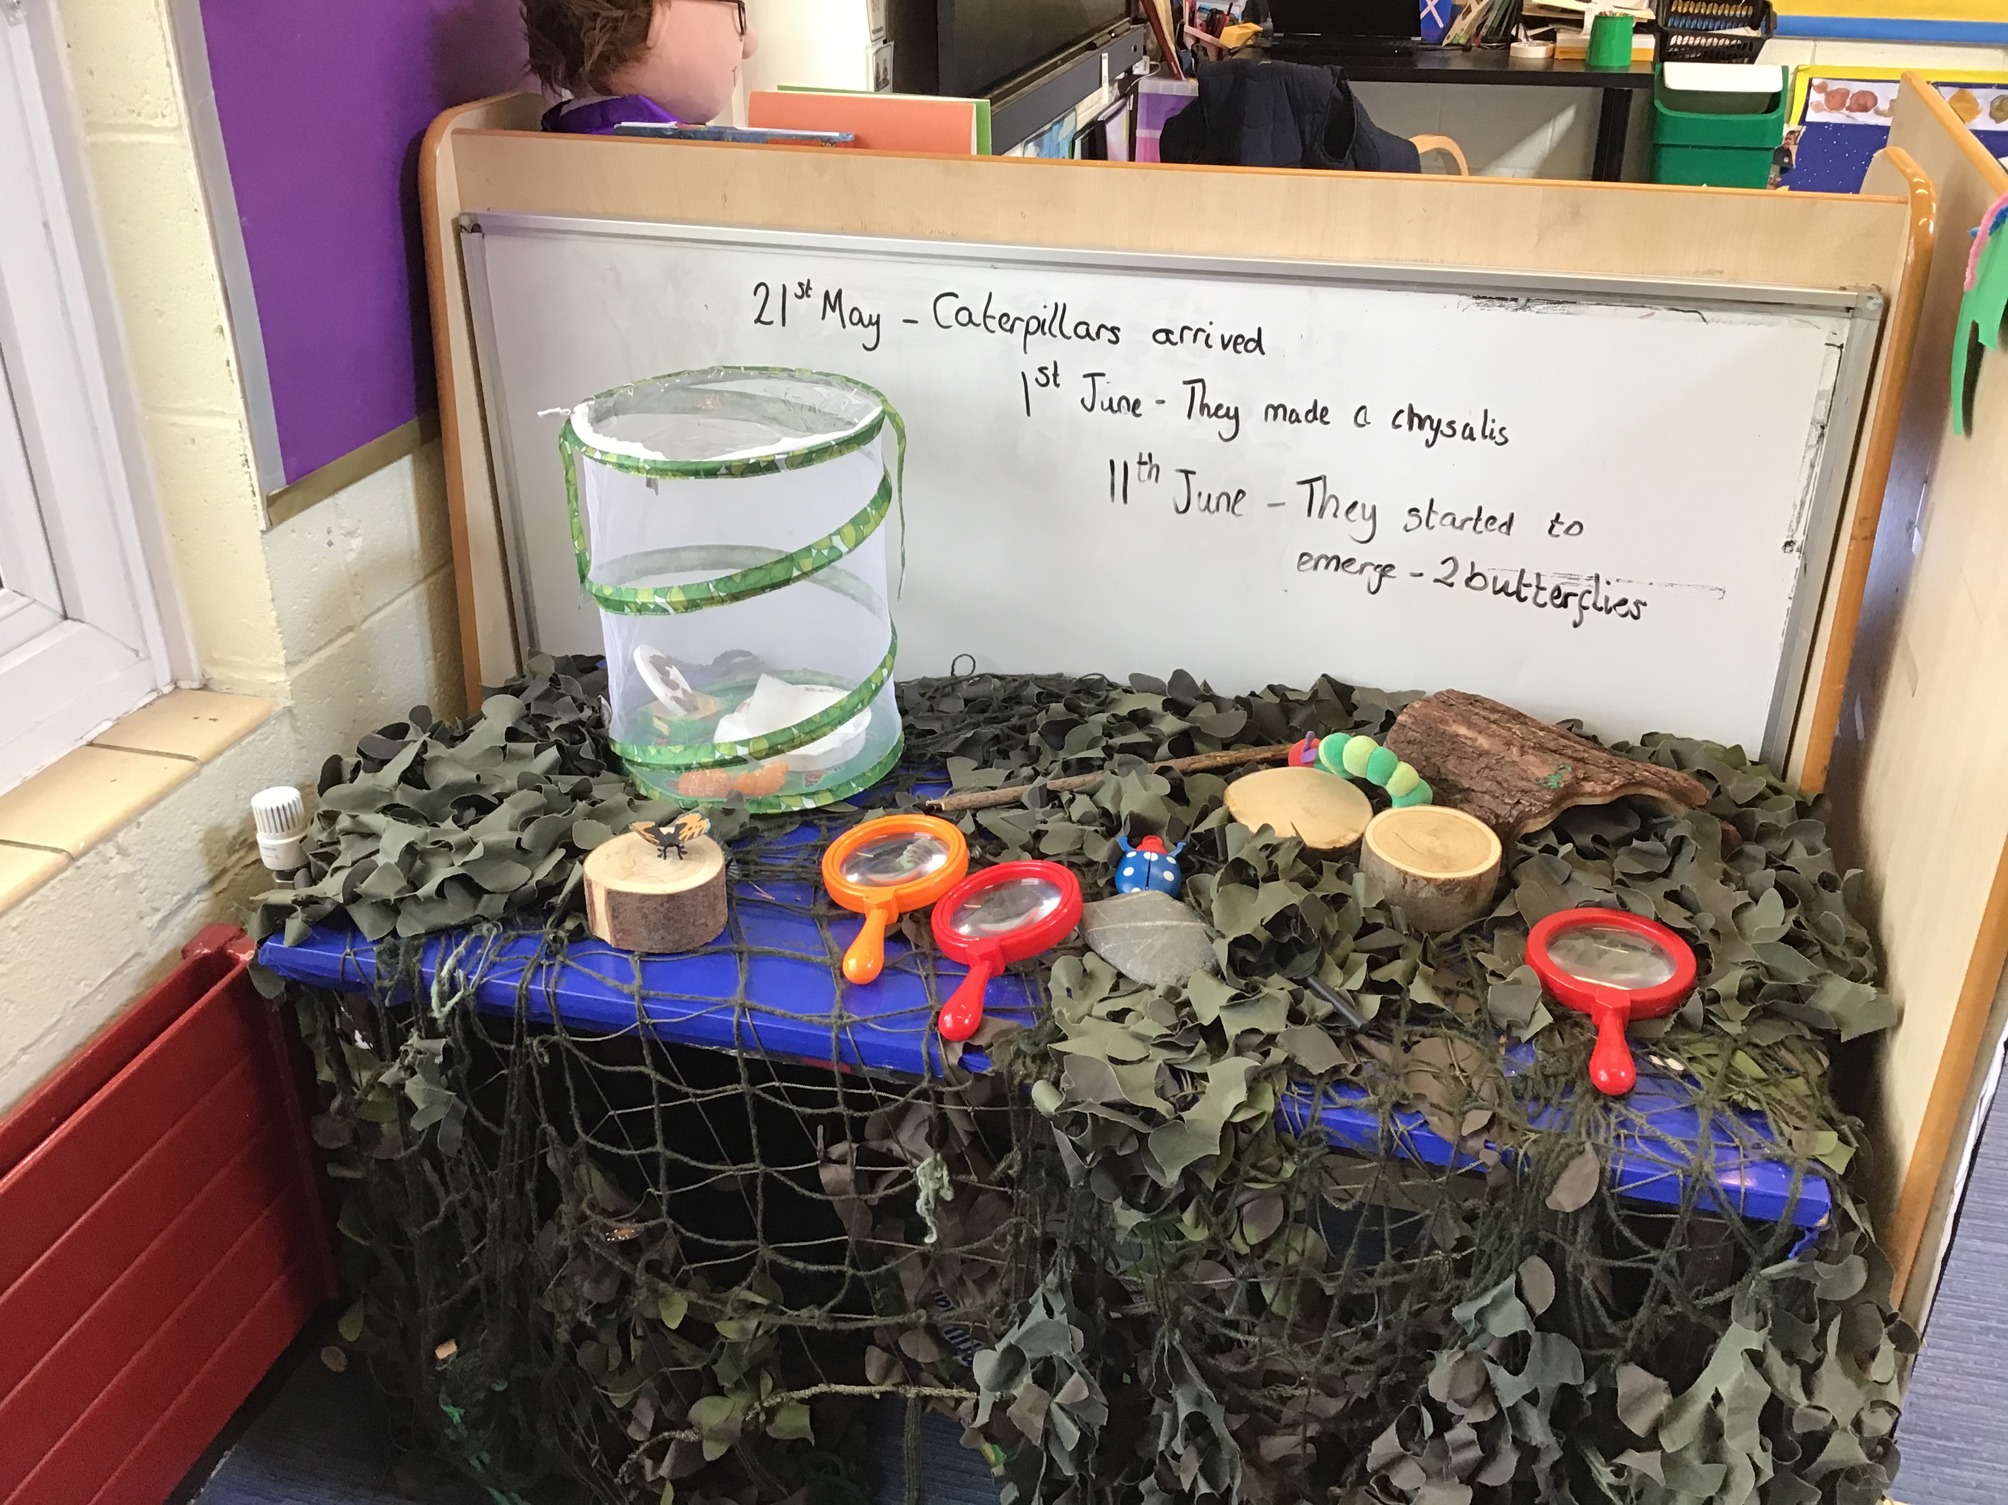
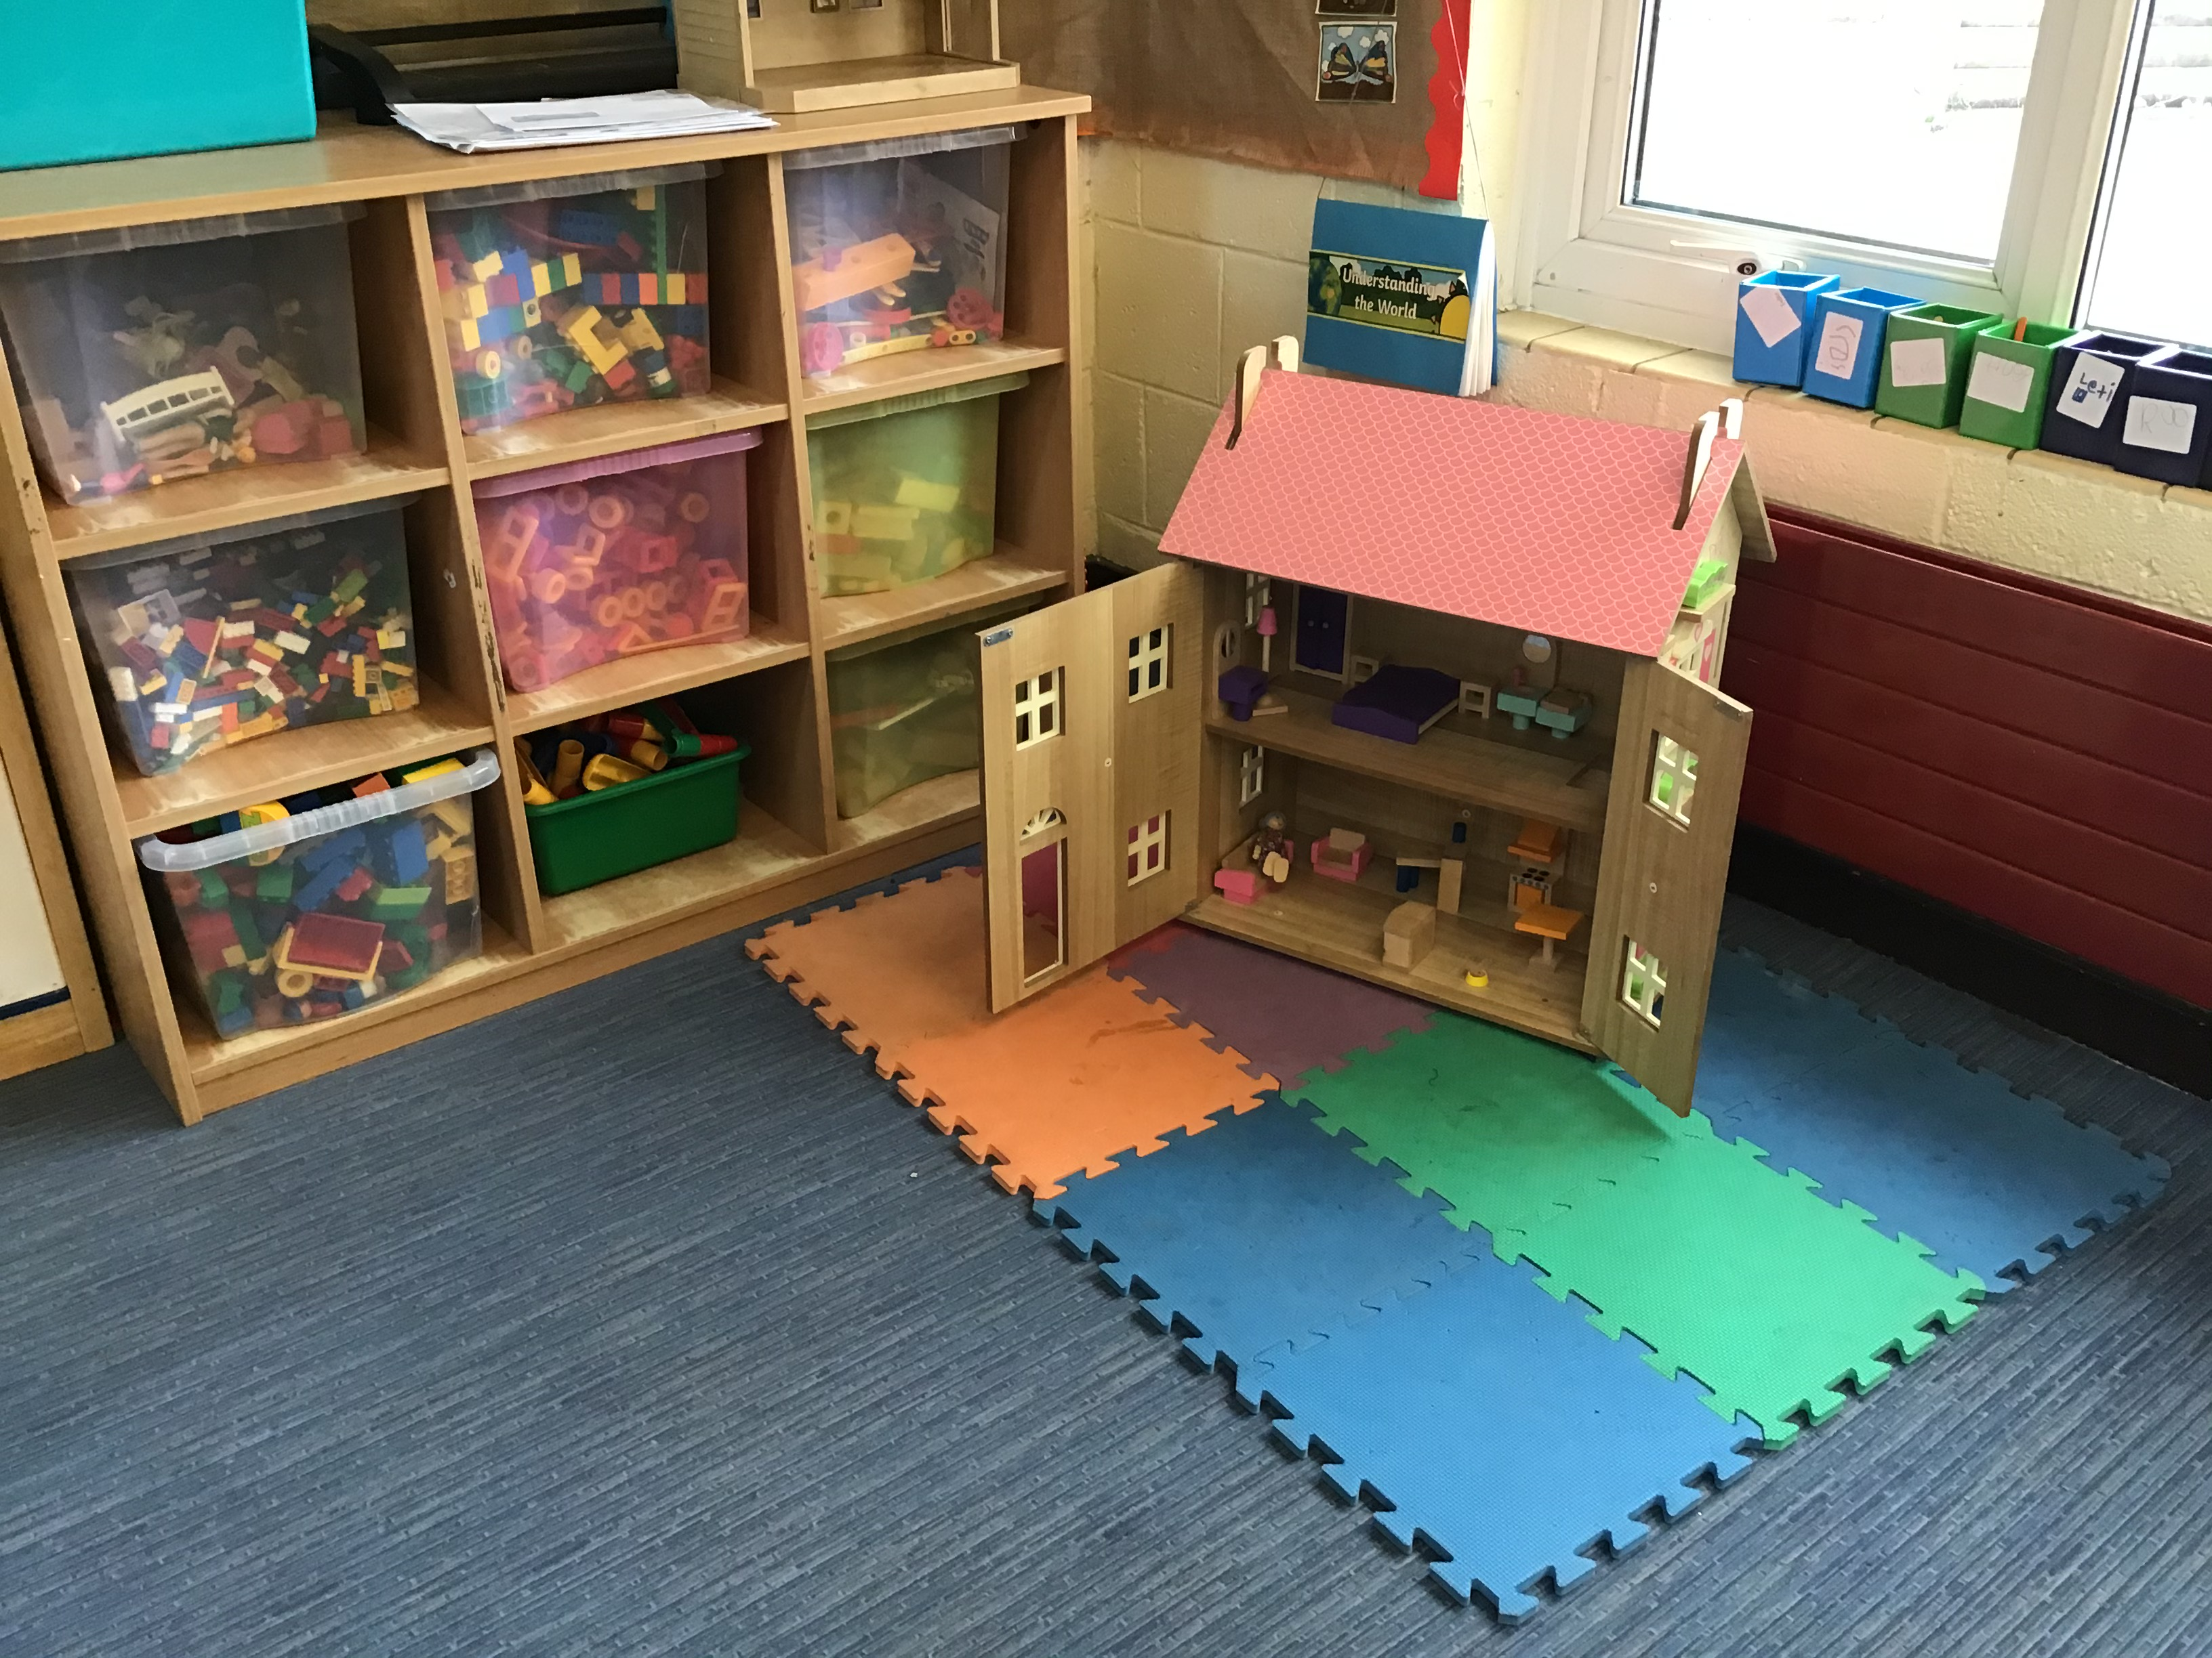
Our indoor classroom…
We like to investigate the world around us and use the construction and small world areas to carry out our plans and tell stories.
In the creative area, we love to paint and use junk materials to make models.

