Slide 1
Tuesday 19th January

Slide 2
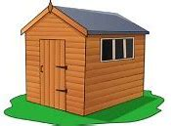
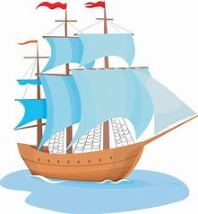
Phonics - Phase 3
Can you guess what our phoneme is today? See if you can write the words

Slide 3
Our phoneme today is…
fish
wash
sh
shut
ship
Can you say these words with our phoneme in? See if you can sound out the words then blend to read

Slide 4
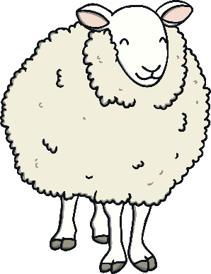
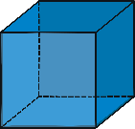
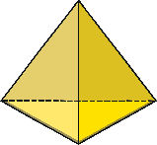
Click the pictures that begin with ‘sh’ to move them into the middle.
sh
x
x

Slide 5
Read the story on the next slide with a grown up to help you. See how many ‘sh’ words you can spot and make a list on your whiteboard.

