Slide 1
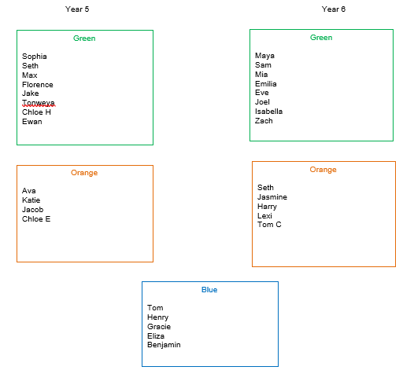
Spelling groups
22.01.21

Slide 2
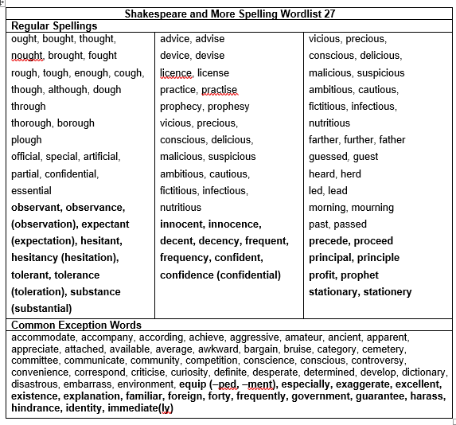
Year 5

Slide 3
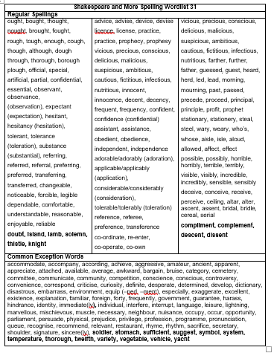
Year 6

Slide 4
22.01.21
Year 5- To be able to spell ​homophones and near homophones.
Year 6- To be able to spell homophones and near homophones.

Slide 5
Year 5- To be able to spell homophones and near ​homophones.
What is a homophone?
A homophone is two words that sound the same but they have different spelling, and different meaning.

Slide 6
Spelling focus: To be able to spell homophones and near homophones.
Your test will be on ​29.01.21
on Teams
Spelling words:
stationary
stationery
precede
proceed
profit
prophet

Slide 7
Year 6- To be able to spell homophones and near ​homophones.
What is a homophone?
A homophone is two words that sound the same but they have different spelling, and different meaning.

Slide 8
Spelling focus: To be able to spell ​homophones and near homophones.
Spelling words:
compliment
complement
descent
dissent
affect
effect
Your test will be on 29.01.21
on Teams

Slide 9
Blue group- High frequency words.
Spelling words:
these
live
away
can't
more
began
say
good
Your test will be on 29.01.21
on Teams

Slide 10
Year 5 & 6
Blue:
You will be tested on the 8 spellings you're given.
Green:
You will be tested on the 6 spellings you're given plus 4 more. I will choose those 4 from the spelling sheet you have.
Orange:
You will be tested on the 6 spellings you're given plus 4 more. The 4 extra spellings may or may not be chosen from the spelling sheet you have.

Slide 11
Spelling task- 22.01.21
This week I would like you to write 6
sentences for the words you have been given to learn. Each sentence must include one of the words.
You must use the words in the correct context, so you will need to know what they mean.
Please can you write this in your red spelling book. You need to underline the 6 spellings I ​gave you.

