Slide 4
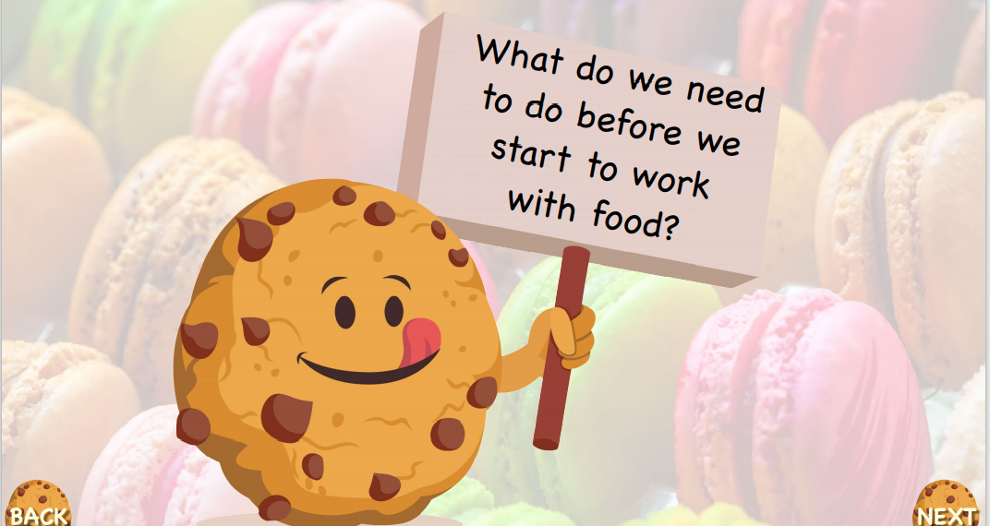

Slide 5
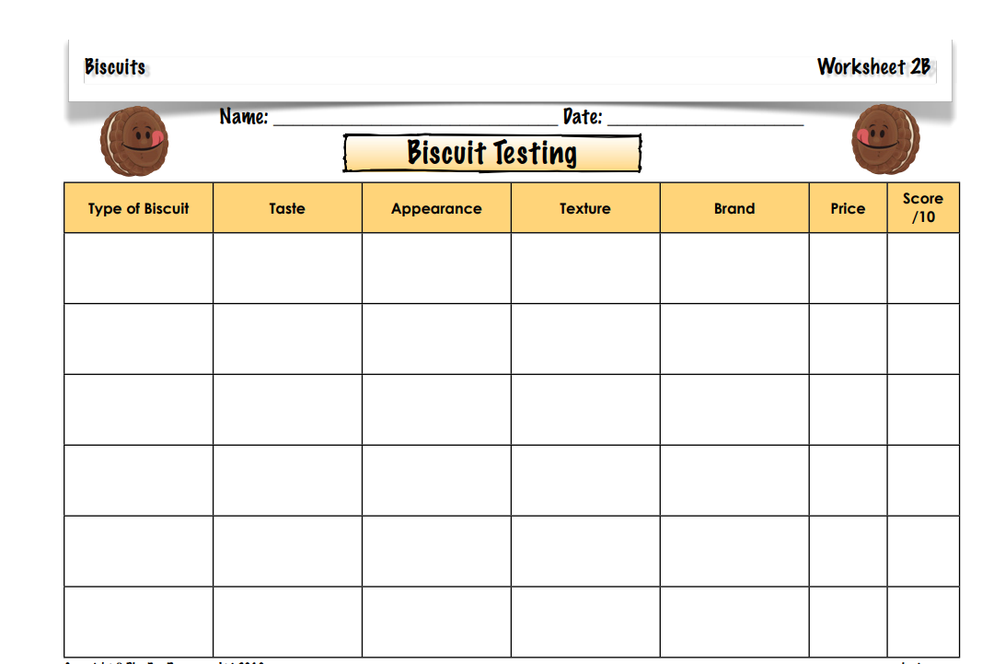

Slide 6
Which biscuit was your favourite? Why?
Which biscuit was your least favourite? Why?
Which biscuit offers the best quality?
Which biscuit was the best value for money?

