Slide 1
Wednesday 3rd February

Slide 2
Phonics - Phase 3
Can you remember the phonemes that we have learned?
See how quickly you can move through the slides saying each phoneme out loud.

Slide 3
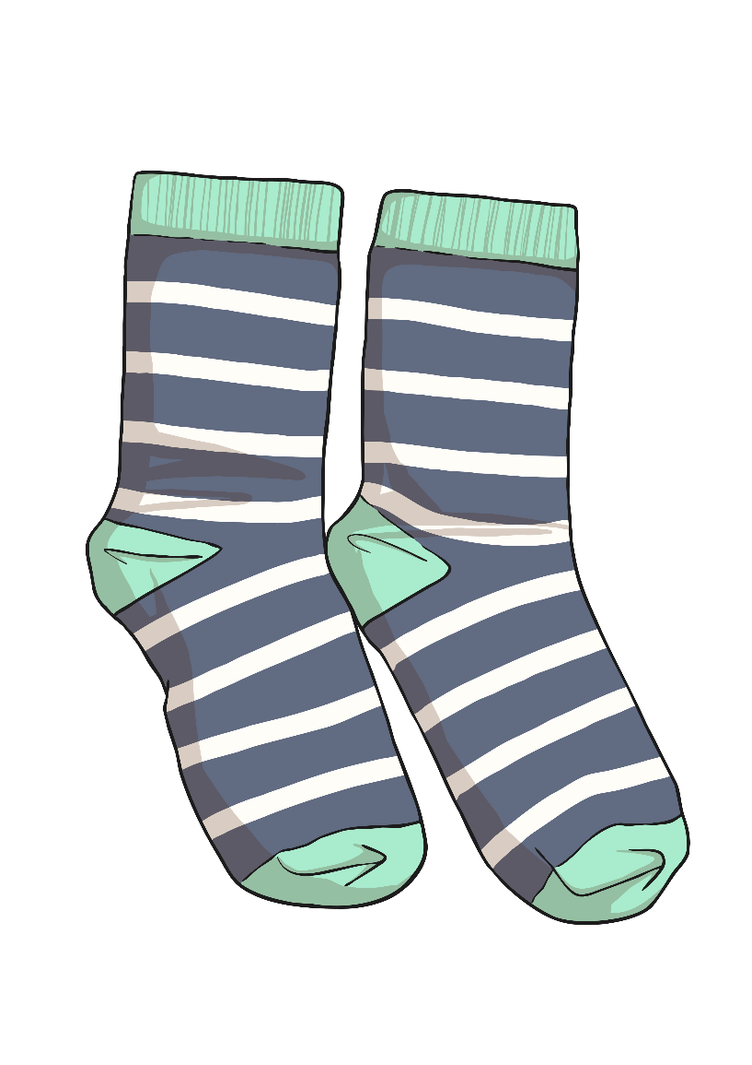
s

Slide 4
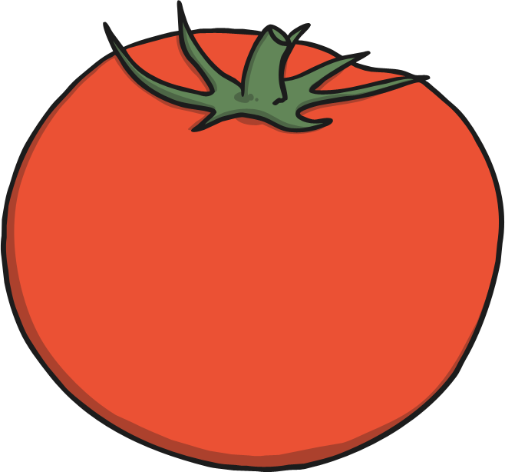
t

Slide 5
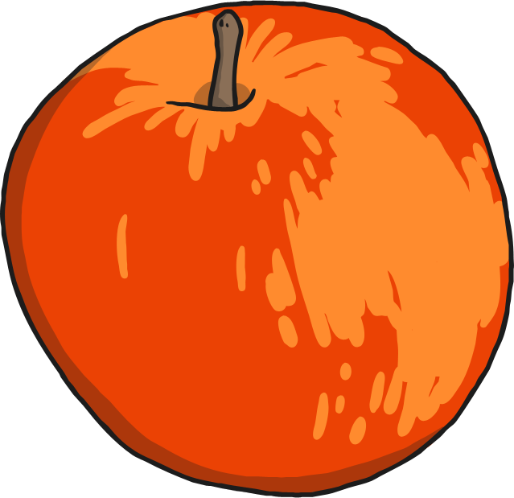
a

Slide 6
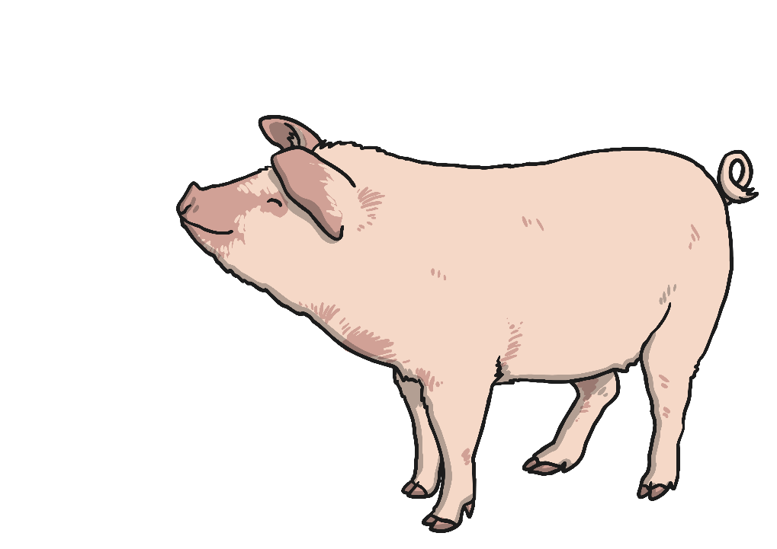
p

Slide 7
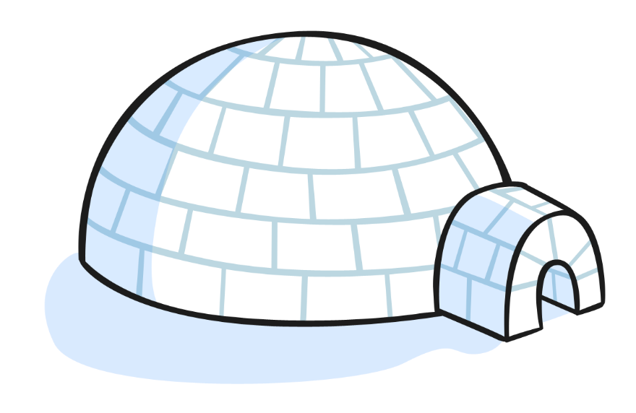
i

Slide 8
n

Slide 9
m

Slide 10
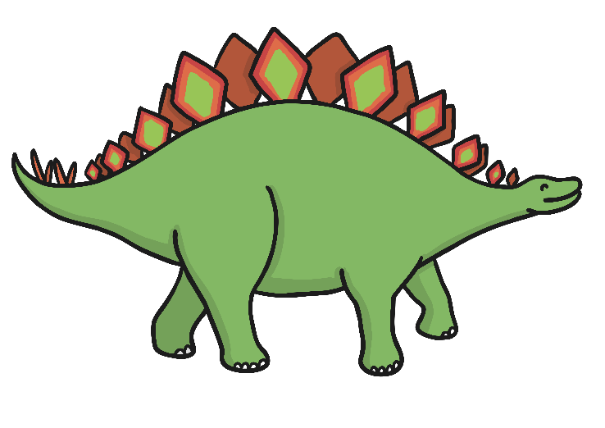
d

Slide 11
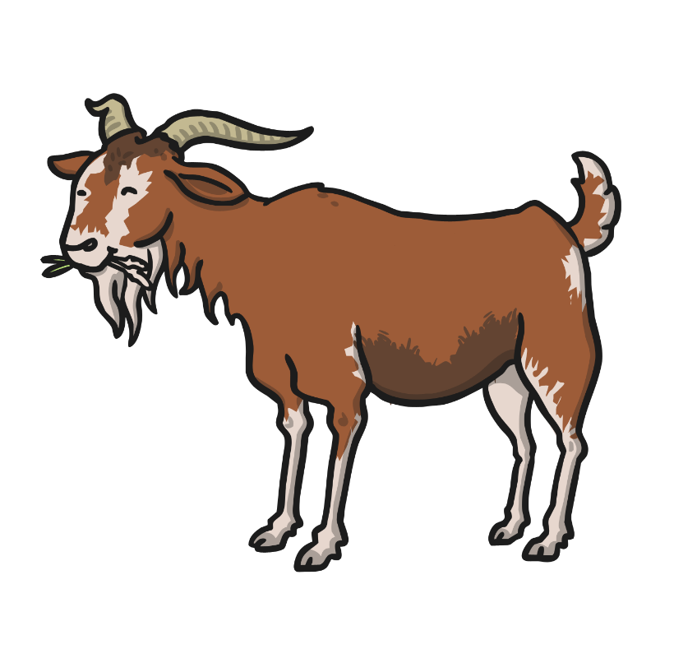
g

Slide 12
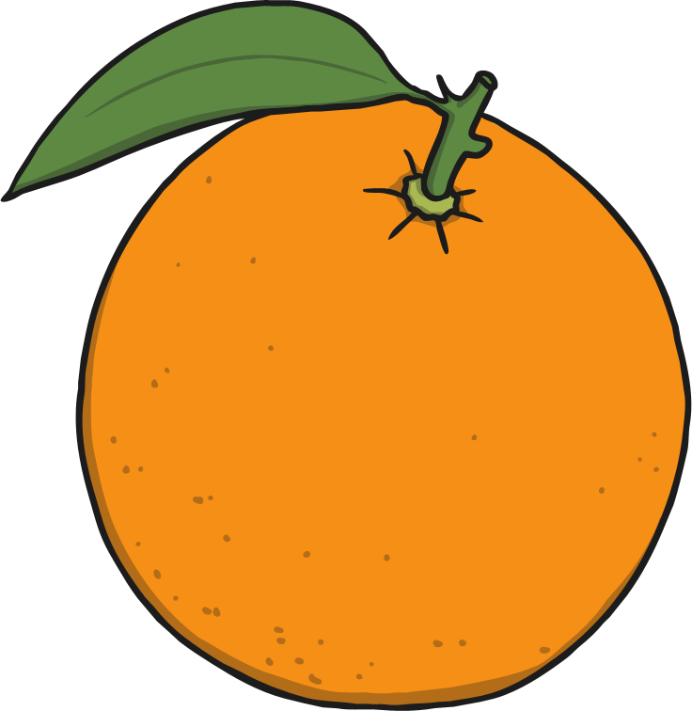
o

Slide 13
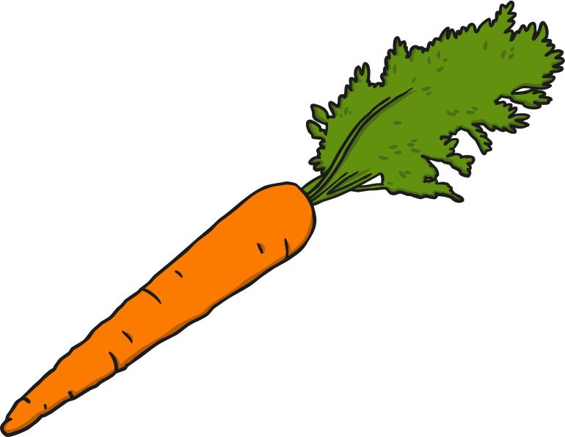
c

Slide 14
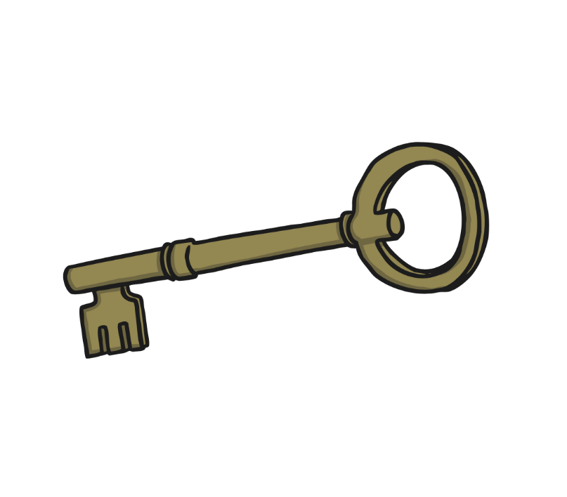
k

Slide 15
ck

Slide 16
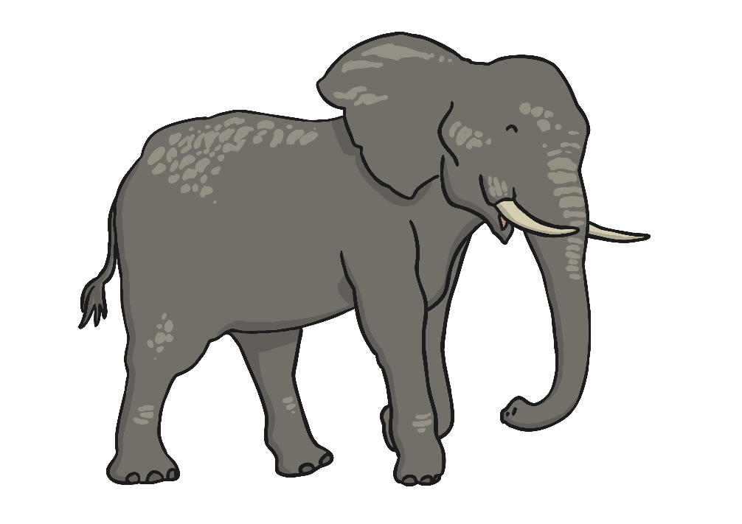
e

Slide 17
u

Slide 18
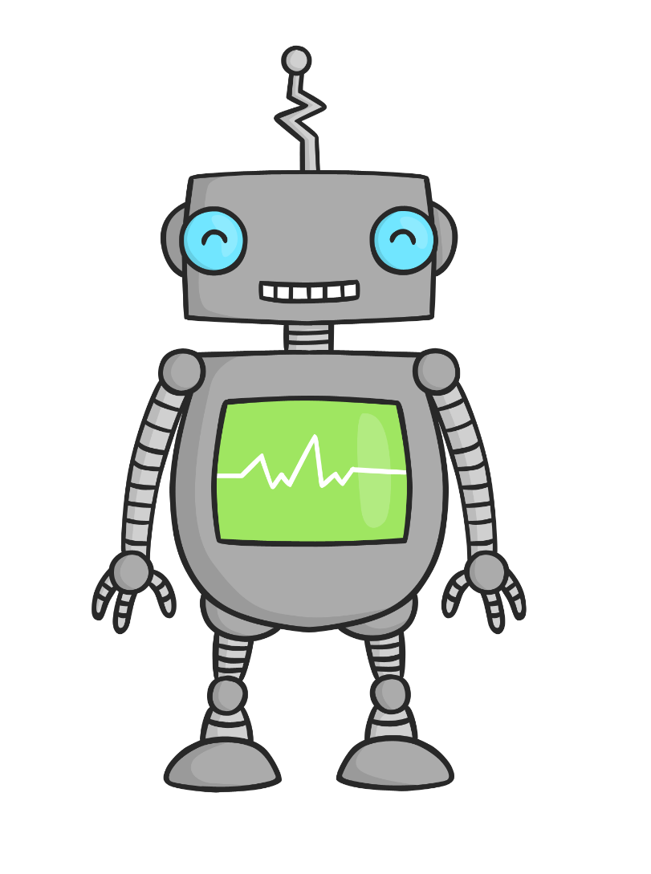
r

Slide 19
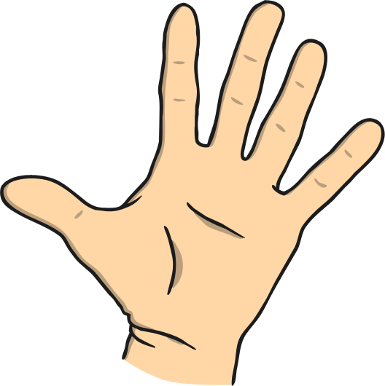
h

Slide 20
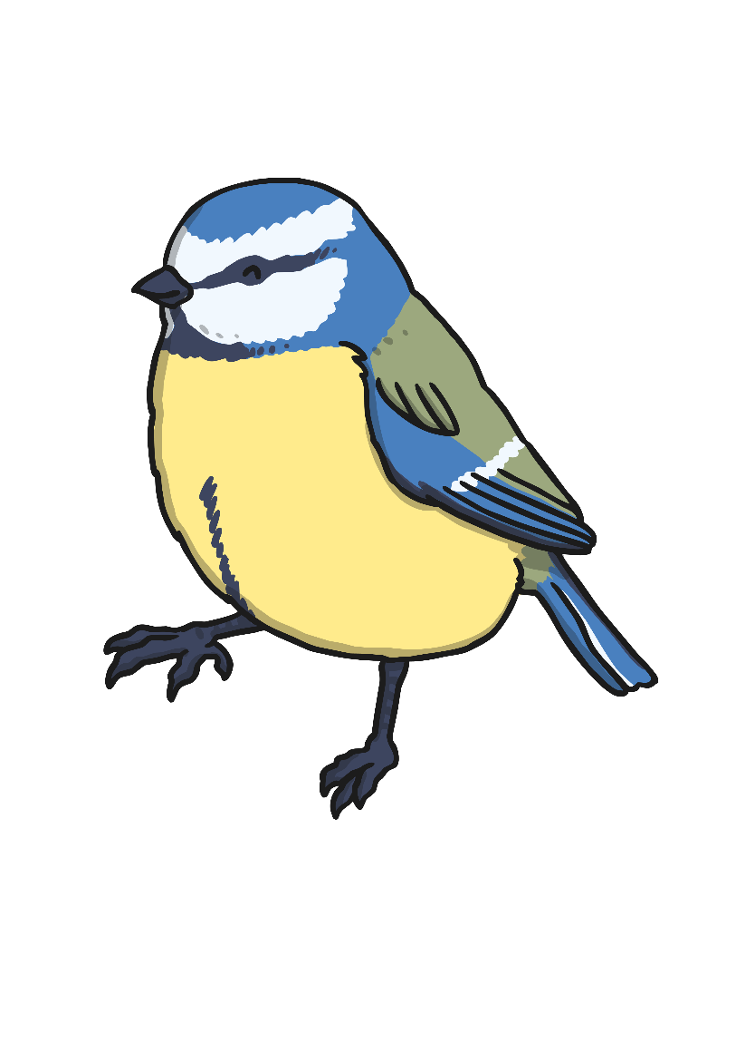
b

Slide 21
f

Slide 22
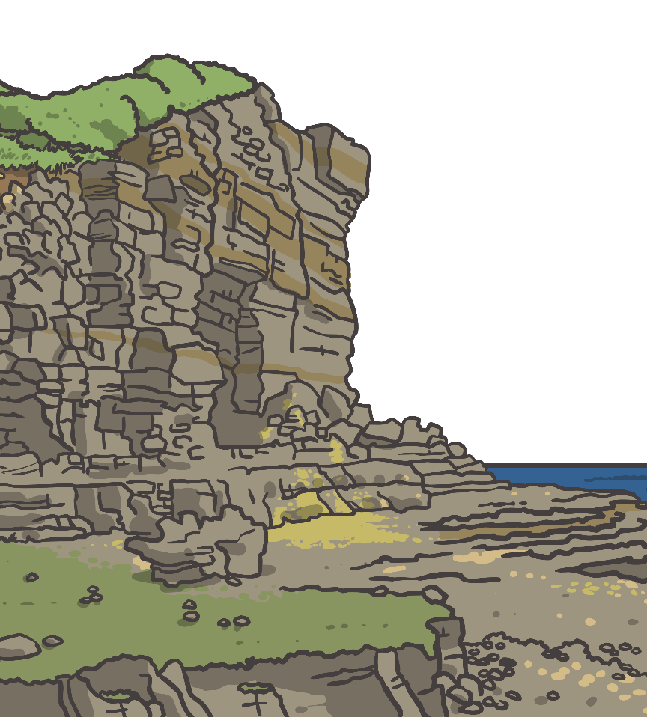
ff

Slide 23
l

Slide 24
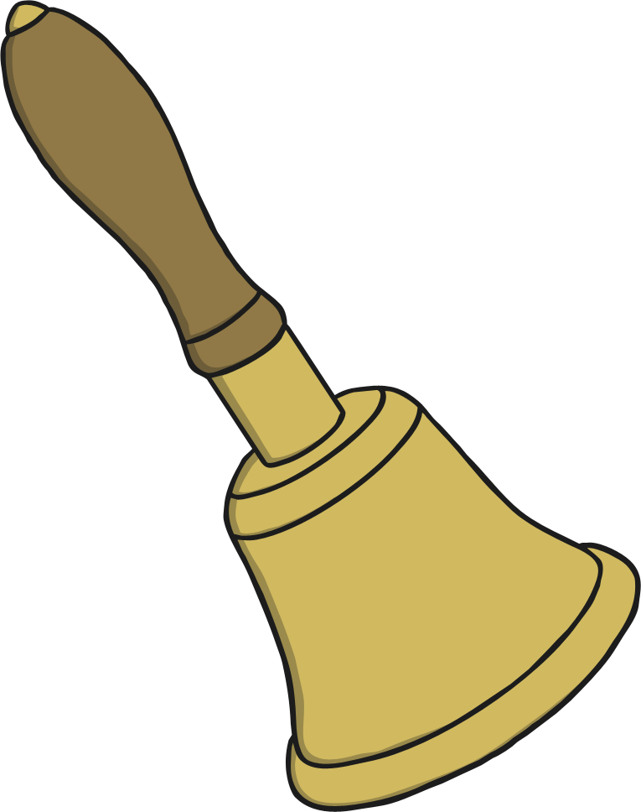
ll

Slide 25
ss

Slide 26
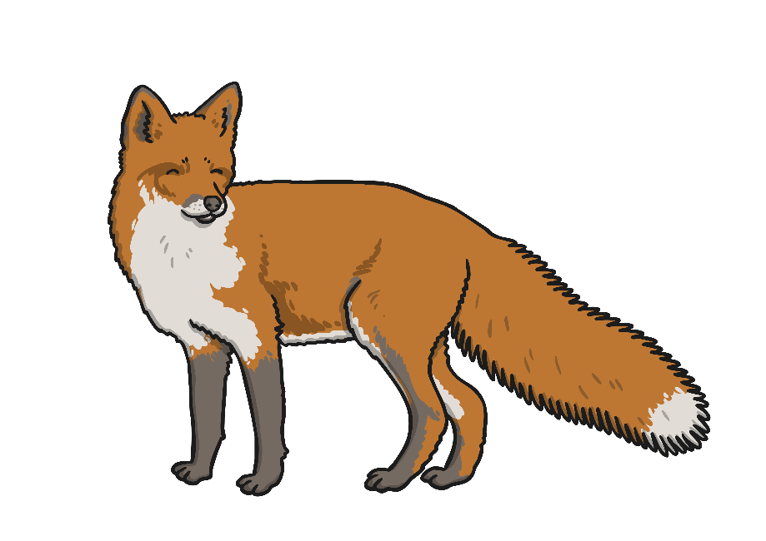
x

Slide 27
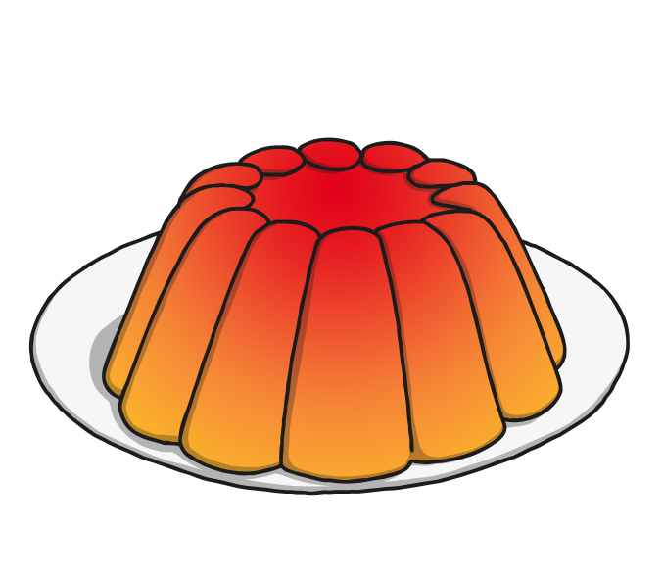
j

Slide 28
v

Slide 29
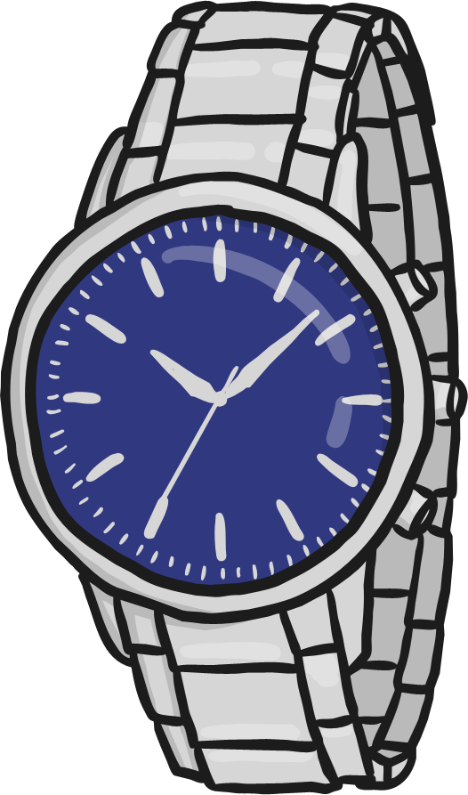
w

Slide 30
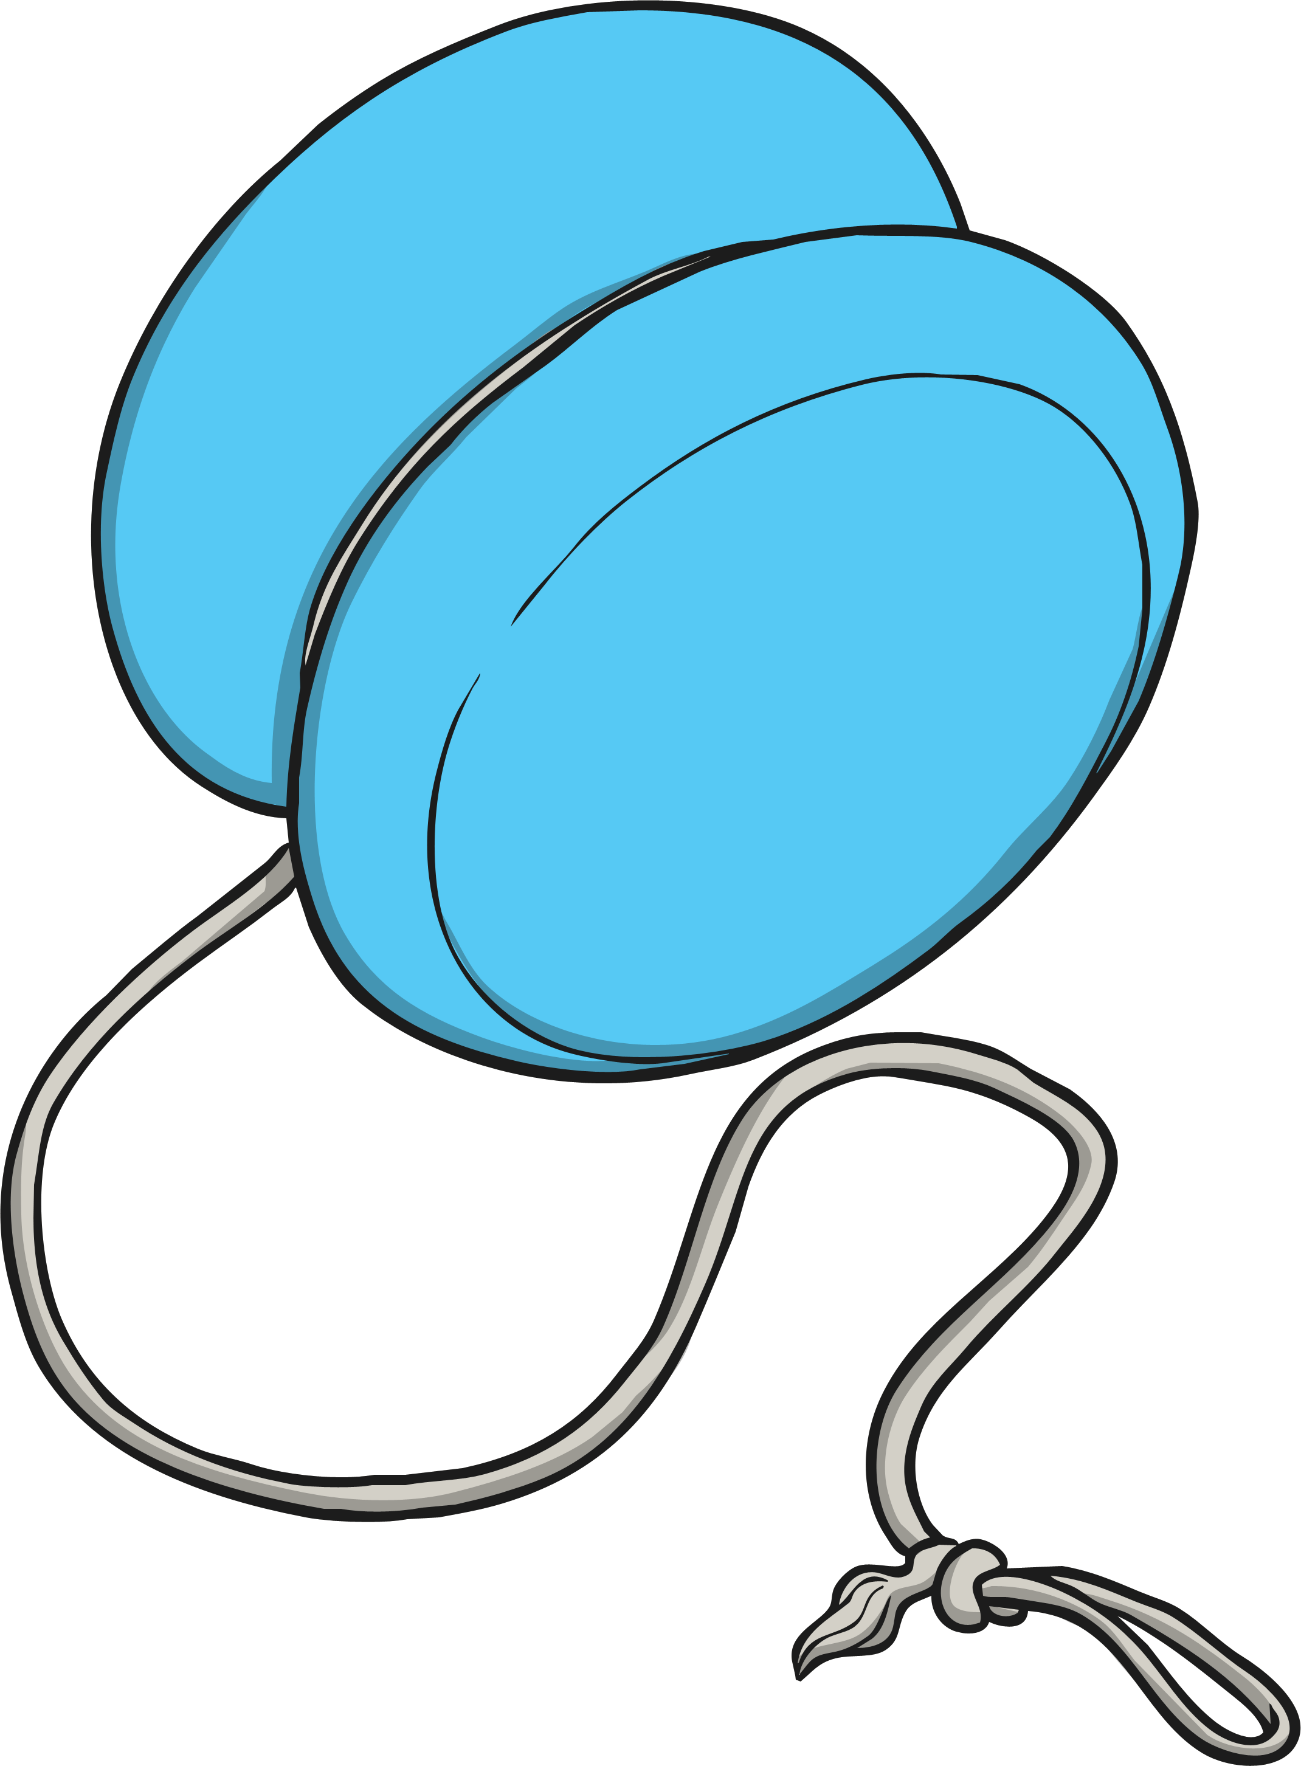
y

Slide 31
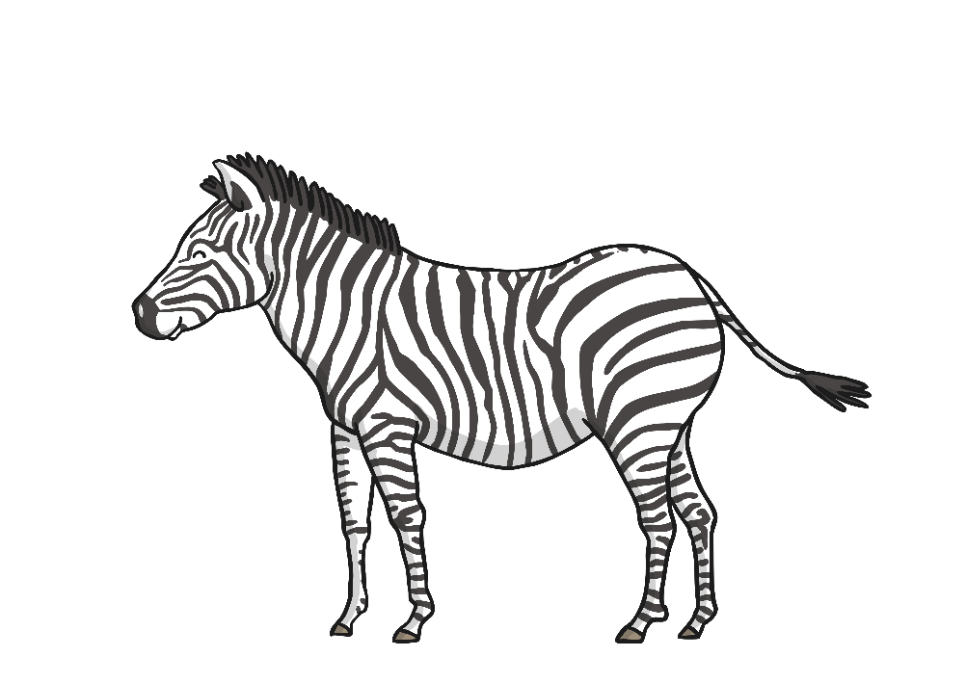
z

Slide 32
zz

Slide 33
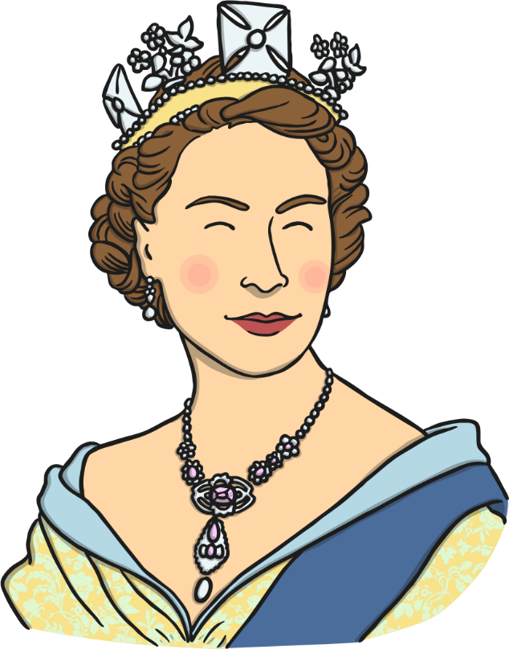
qu

Slide 34
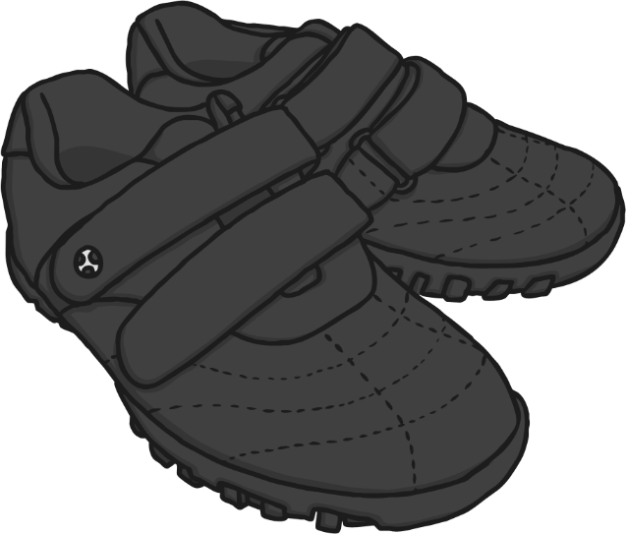
sh

Slide 35
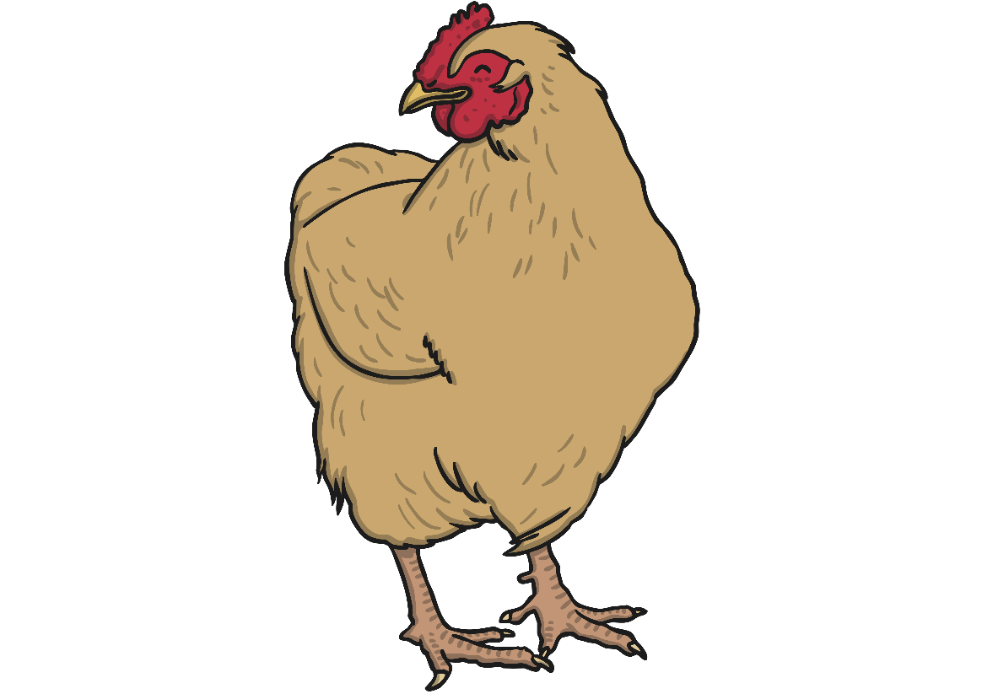
ch

Slide 36
th

Slide 37
ng

Slide 38
ai

Slide 39
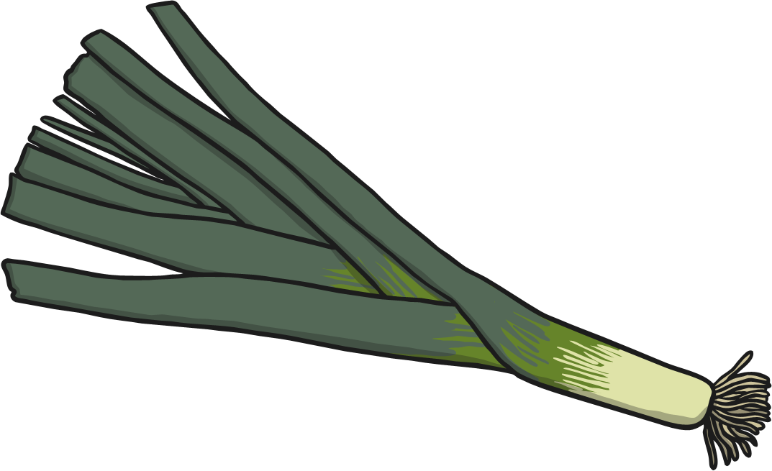
ee

Slide 40
igh

Slide 41
oa

Slide 42
oo

Slide 43
oo

Slide 44
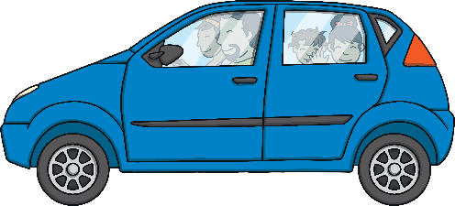
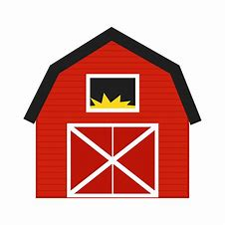
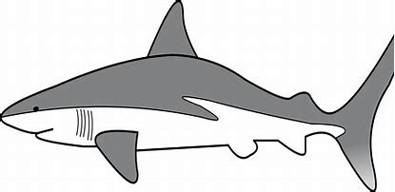
Phonics - Phase 3
Can you guess what our phoneme is today?

Slide 45
Our phoneme today is…
Can you read the ‘ar’ words?
shark
star
ar
farm
harm

Slide 46
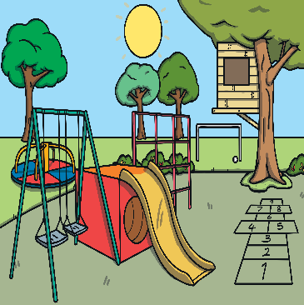
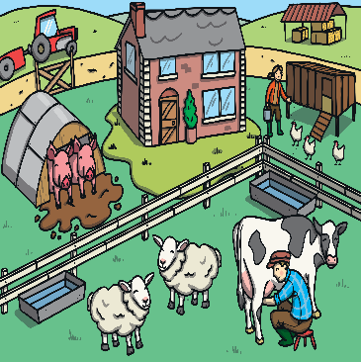
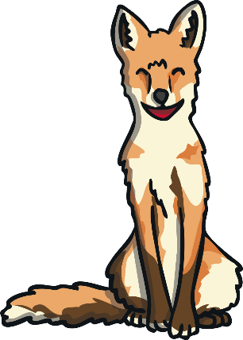
Click the pictures that contain the ‘ar’ sound to move them into the middle.
ar

Slide 47
Phoneme Spotter Story
Carl the shark had always wanted to live on a farm but he did not have any legs to walk on sand. He swam in the water close to Farmer Ned’s farm each day, watching as the animals moved around the barn.
One day Farmer Ned’s wife noticed how sad Carl looked so she arranged for all of the animals to walk down to the sea to visit Carl. They all enjoyed it and didn’t think it was that far to walk even though it may have been quicker to travel in the car.

