Slide 1
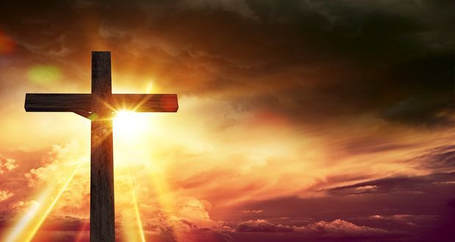
Was Jesus the Messiah?
Lesson 2

Slide 2
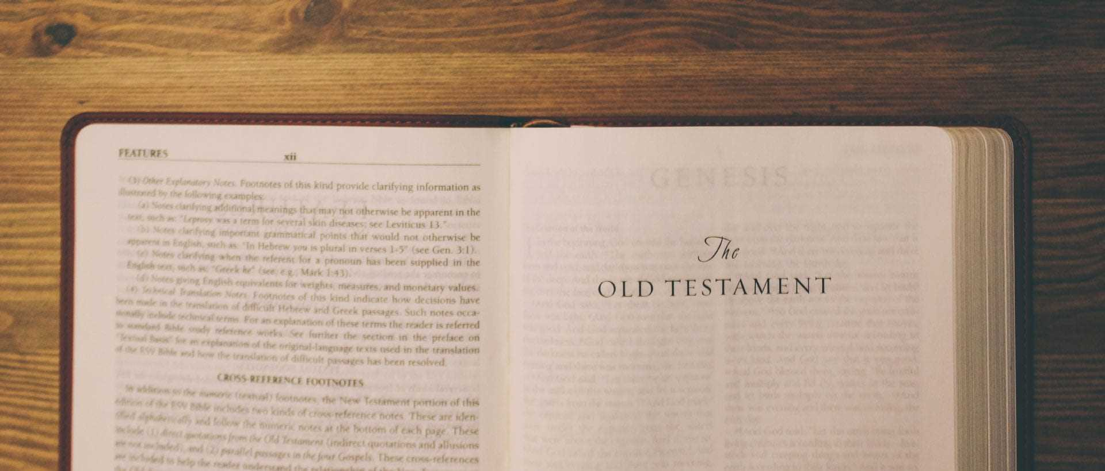
LI: To identify Gospel and prophecy texts, using technical terms.
LI: To explain connections between biblical texts, Incarnation and Messiah using biblical terms.

Slide 3
Can you remember what we looked at last lesson?
What is a Messiah?
Why were the Jewish people hoping for a Messiah?

Slide 4
Some of the followers gradually began to believe that Jesus was the Messiah and that he fulfilled the prophecies.
Read through a written report from the scene. This is on the next slide.
Look at some of the evidence in Matthew’s Gospel that led Christians to believe this. What clues are there that Jesus is the promised Messiah?
Link each of the expectations by highlighting or drawing a line to one or more clues in the text.

Slide 5
Example
Link these expectations to clues in he text.

Slide 6
Most Jewish people at the time did not believe Jesus was the Messiah — and Jewish people today still do not think he was.
Mary & Joseph would have been familiar with the prophecies before they had their baby, Jesus.
I wonder how they would have felt when they had their baby and it fulfilled many of the prophecies.

Slide 7
If we could speak to Mary & Joseph, I wonder what they would say to answer these questions...
How do you feel?
What might this mean?
Does any of this scare you?
Do you feel privileged to possibly fulfill the prophecies?
Do you think your son is the Messiah? Why? Why not?
Jot down some ideas for what their answers might have been...

Slide 8
I would like you decide whether you believe Jesus was the Messiah?
Are you in agreement with a Christian (they believed Jesus was the Messiah) or a Jew (they didn't believe Jesus was the Messiah)?

Slide 9
What is the evidence to suggest that Jesus was the Messiah?
I would like you to write and illustrate a newspaper report claiming that the Messiah has arrived, and is Jesus, comparing it with the Jewish expectations expressed in your ‘Wanted: Messiah’ poster.

Slide 10
It would be great if you would send me your newspaper report so that I can see what you've done.
If you've created your newspaper report on a computer you can upload it to Teams, or you could photograph it and send a photo of it to me at class4@gfschools.co.uk

