Slide 1
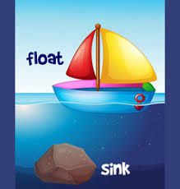

Slide 2
How do we know if an object will float or sink?
Gather some objects from around you house and see what happens when your put them in a container of water.
Make a prediction, before you try each object and then see if you are right.

Slide 3
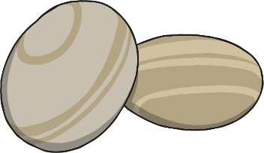
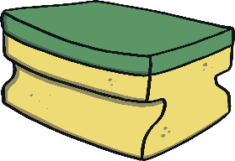
Why do some objects sink?
Heavier
Some objects are heavier so they sink. Objects like marble, coins and stones sink.
Lighter
Some objects are lighter so they float. Corks, sponges and wood will float.

Slide 4
What about shape?
The shape of an object matters too. When more of the object is touching the water then it's more likely to float
Using playdough or plasticine see if you can make a shape that sinks and one that floats.

Slide 5
Can you make a boat for the penguin and the boy from Lost & Found?
Use materials from around you house to make a boat. Is it heavy or light? Can you change the shape to help it float?
Use an object to be your penguin and check it floats.

