Slide 1
‘Ow’ Words
Can you read these words?

Slide 2
c
ow

Slide 3
h
ow
l

Slide 4
g
ow
n

Slide 5
r
c
ow
n

Slide 6
r
c
ow
d

Slide 7
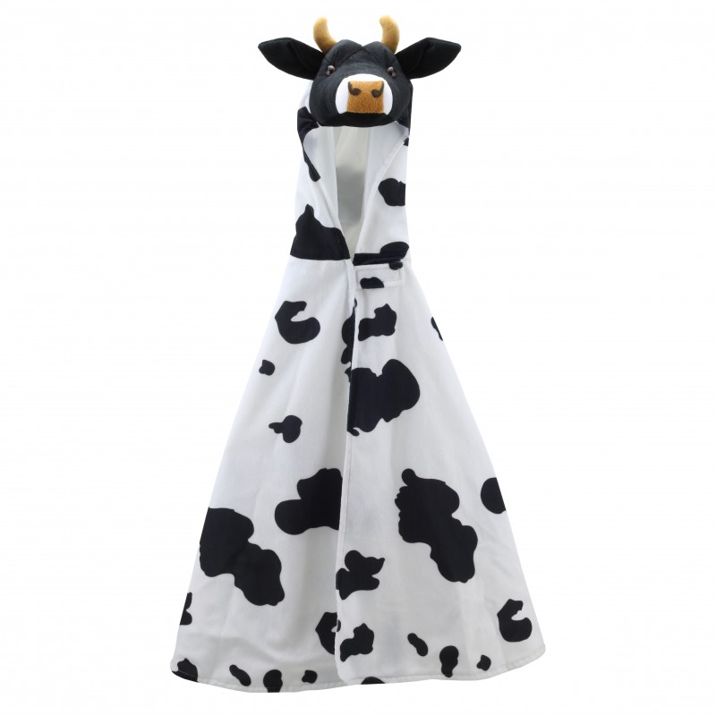
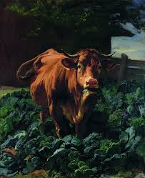
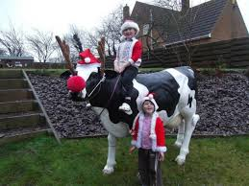
g
Which picture matches with this sentence?
n
ow
c
ow
i
A
n
a

Slide 8
g
n
ow
c
ow
i
A
n
a

